Slide 1
Long a sound /ā/
Created by Jen Graham
Australian Curriculum Lessons

Slide 2
Learning Intention
To recognise the long a sound in a word and begin to connect the letters to correctly spell the word.
To hear the phoneme /ā/ in words and connect the phoneme to the right graphemes.
Success Criteria
I can hear the long a sound in words.
I can hear the long a sound at the end of the word and use ay to represent the long a sound.
I can hear the long a sound at the end of the word ‘they’ and remember it is spelt they.
I can hear the long a sound in the middle of the word and know most of the time I will need to use the letters ai or a...e to represent the sound.
I can name one spelling generalisation which represents the long a sound.

Slide 3
A Brief Introduction/Overview
graphemes (letters) - There are 26 letters in the English alphabet
phonemes (sounds) - There are approximately 44 sounds
There are over 200 spelling variations of the 44 sounds.
This unit looks at the long a phoneme which will be written /ā/ and the different graphemes (letter combinations) which are used to represent the /ā/ (long a sound)
Spelling generalisations help us select the correct group of letters (graphemes) which represent each phoneme (sound). They are called generalisations because they are generally correct but some have exceptions.
Base word, suffix, prefix reminder https://www.youtube.com/watch?v=8XqGqbso_4o

Slide 4
When we spell we need to HEAR the phonemes (sounds) in words. Once we HEAR the sounds we need to connect the sound to the correct LETTERS (graphemes).
For example:
dog - hear 3 sounds d-o-g connect 3 letters dog
shop - hear 3 sounds sh-o-p connect 4 letters shop
You would have already learnt the short vowel sounds - https://www.youtube.com/watch?v=ZSgoItXUcHQ&t=47s
(song of short vowel sounds Australian accent)
Short vowels are usually the easiest as one sound connects to one letter - you usually begin spelling CVC words which means consonant vowel consonant. You may have also used the words ‘most common sound’ when learning letters for example
The letter b, most common sound is /b/ as in bed
The letter t, most common sound is /t/ as in tag
Therefore, the word bat is easy to spell because one sound connects to one letter - b-a-t.

Slide 5
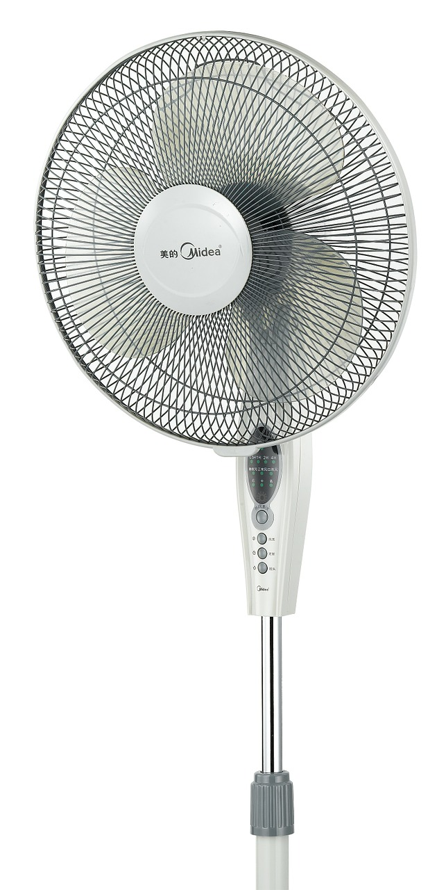
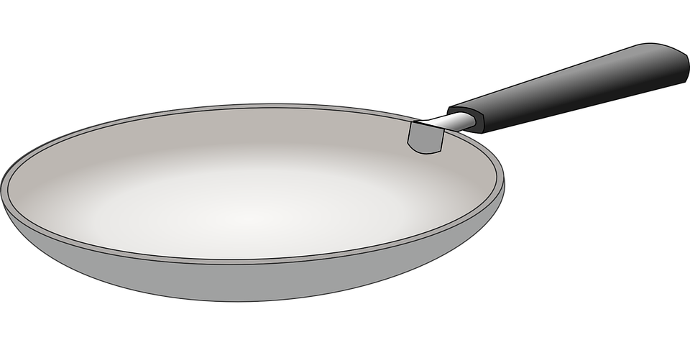
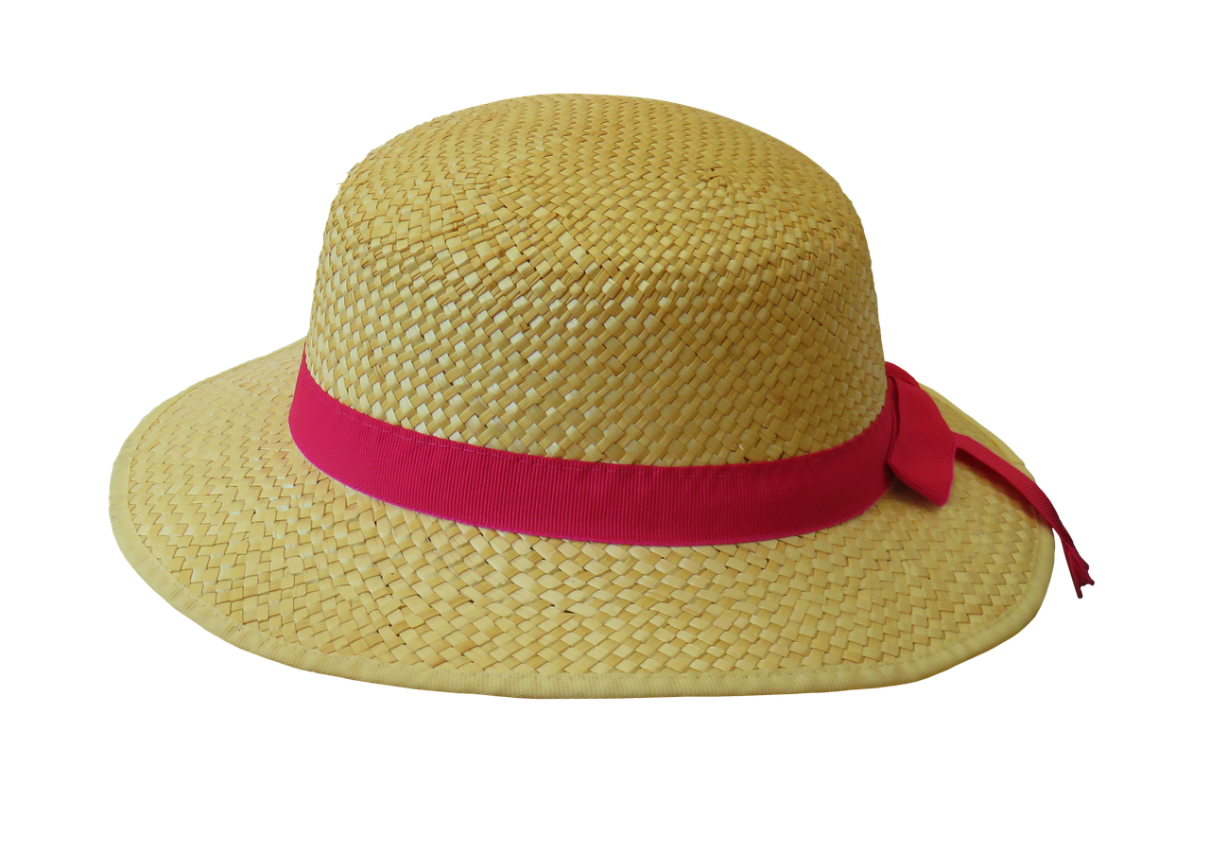
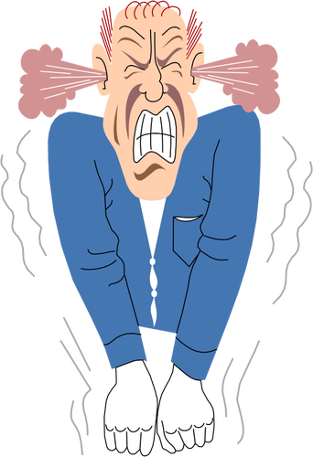

Have fun saying and spelling these CVC words with your partner. Remember to say the word slowly to hear and say each of the phonemes (sounds). Connect each sound to the letter.
Notes:
Answers: pan, hat, fan, mad, tap

Slide 6

It would have been simple if spelling was hearing one sound and connecting it to the one letter as in the CVC words however English is never that simple.
This video shows the 20 Australian English phonemes (sounds)
https://www.youtube.com/watch?v=_4_Jx-7lOeM
This unit will help you learn the different letter combinations which make up the /ā/ .
The /ā/ (long a vowel sound) - https://www.spelfabet.com.au/spelling-lists/sorted-by-sound/ay/
The /a/ (short a vowel sound) - https://www.spelfabet.com.au/spelling-lists/sorted-by-sound/a/
Use a mirror or a partner to say the short /a/ sound and the long /a/ sound.

Slide 7

Can you hear the /ā/ in words?
Repeat these words after me - then stand if it has the long a sound /ā/.
It always helps to say the word slowly and stretch out each sound.
stick made run cat rain slow
may like fun eight stay
tube they fan spot run spade
Note: If students have difficulty hearing the phonemes in words they may need to be tested on their phonemic awareness.

Slide 8
The purple words have the long a sound as you can see they have different letter combinations which make the single sound and some, don’t even use the letter a.
stick made run cat rain slow
may like fun eight stay
tube they fan spot run spade

Slide 9

Brainstorm with your partner/group all the words you can think of which have the long a sound. It might help to group them in same letter combinations.
Here are some of the more common letter combinations for the long a sound /ā/.
a-e as in date ai as in rain
ay as in pay
Can you think of any other letter combinations which make the long a sound?

Slide 10
Some of the words which may be on your list - add these to your Word Wall or Sound Study section in the classroom.
a-e as in date | ai as in rain | ay as in pay
ape make base blade flame game grade mate wake wave Take tape flake snake | aim bait chain claim fail faint faith mail saint tail sprain faint waist train | bay cray day say pay ray stay play may way sway spray

Slide 11
Some of the other letter combinations you may have found which make the long a vowel sound.
eigh as in eight, freight, sleigh, weigh, neighbour, weight
ea as in great, break, steak
ei as in vein
ey as in they grey
è as in café
And some more rare combinations
ae as in sundae, vertebrae
ê as in fête
aigh as in straight

Slide 12
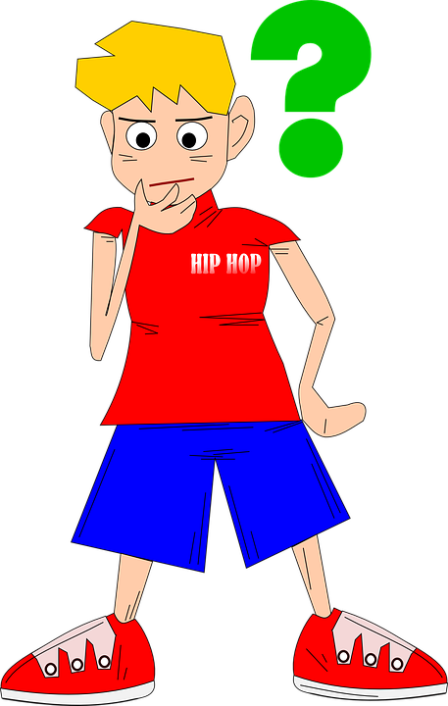
With so many letter combinations how do you know which to use when you hear the long a sound?
Good question.
Spelling generalisations may help.
Spelling generalisations can help us to choose the right letter combination for the sounds we hear in the word.
We don’t say ‘spelling rules’ because we want you to remember that ‘generally’ the letter combination is correct but sometimes there are words which are an exception.

Slide 13
ay
Spelling Generalisation - when you say a word and you hear the long a sound at the end of the word, use the letters ay to represent this sound for example, day, say, today and pray.
If you hear the long a sound at the end of a syllable use the letters ay to represent this sound, such as payment and haywire. This may also be due to suffixes added to base words or a compound word.
There are some words which are an exception to this spelling generalisation such as - they, weigh
Levelled Spelling List
day say may lay ray | play stay today tray pray | maybe replay midday anyway betray | Saturday hooray birthday holiday payment
This section may lead into adding suffixes such as ed, ing, s on the end of base words or compound words.

Slide 14
a...e
Spelling generalisation - the most common letters which represent the long a sound in the middle of a word are a...e. The .... represents the consonant which is in the middle of the a and e.
Exceptions - there are many exceptions to this generalisation as another common spelling is ai.
Levelled Spelling List
made cake make name came | place space shave blame replace | locate became disgrace Inflate replaced | anticipate hibernate devastate earthquake navigate

Slide 15
ai
A short video to begin to understand when to use ai or ay.
https://www.youtube.com/watch?v=BGrIyCT7nK0&index=10&list=PLU64Y8D9Ds5yNcBJKqoKFgDKK81YxCavd&t=0s&app=desktop
mail paid nail fail sail | trail train snail chain paint | bandaid painful complain reclaim sustain | sustainability entertainment mermaid complaint explain

Slide 16
Some Less Common Variations
a as in bacon, able, agent, baby, paper
ey as in grey, hey, they
aigh as in straight
ea as in great, break, steak
eigh as in eight
e as in cafe, rodeo
ae as in sundae, reggae
e..e as in fete

Slide 17
Spelling Strategies
Sometimes even if you know all the spelling generalisations it is still hard to know which letters to use to represent the sound and spell the word correctly.
Here are a few spelling strategies:
Using your knowledge of how to spell one word and rime, to spell another word https://www.youtube.com/watch?v=pL5AZnxfEfU
If you keep forgetting how to spell a tricky word which doesn’t follow a generalisation then maybe try this handy hint
https://www.youtube.com/watch?v=4nOacQTEIik&list=PLScnAOeIJnBHJVP6z2_XQTiVBsiuNxYJ7&index=13
They - They had eggs yesterday. A Mnemonic.

Slide 18
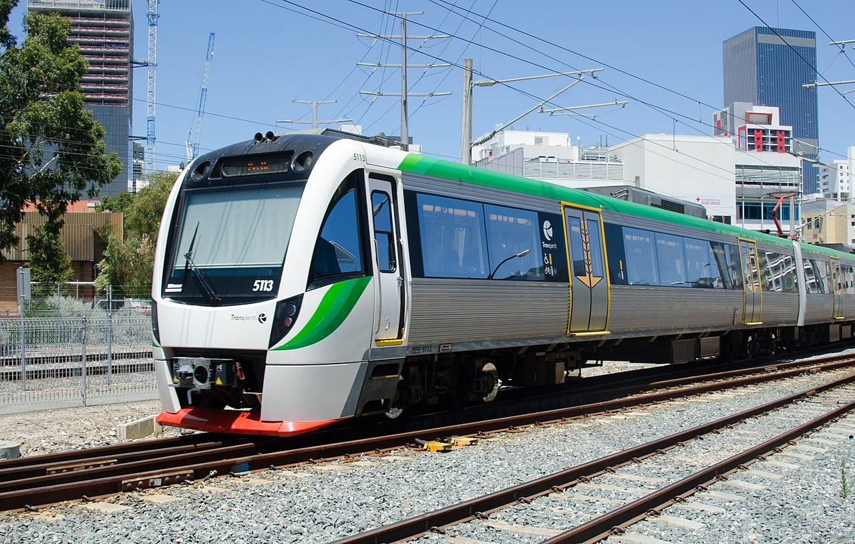

Read, Read, Read!
Remember to read daily. The more you read, the more words you have seen and the easier it will become to spell words.
For example say you wanted to spell this word
Write down the different letter variations you could use for the long a sound.
trayn train trane treighn trean
Then look at each word and decide which one you believe looks correct.
Remember to re-read the words you spell to check they look right.

Slide 19
Australian Curriculum Outcomes
Level Three
Orally manipulate more complex sounds in spoken words through knowledge of blending and segmenting sounds, phoneme deletion and substitution in combination with use of letters in reading and writing (ACELA1474 - Scootle )
Understand how to use knowledge of digraphs, long vowels, blends and silent letters to spell one and two syllable words including some compound words (ACELA1471 - Scootle )
Build morphemic word families using knowledge of prefixes and suffixes (ACELA1472 - Scootle )
Use knowledge of letter patterns and morphemes to read and write high-frequency words and words whose spelling is not predictable from their sounds (ACELA1823 - Scootle )
Use most letter-sound matches including vowel digraphs, less common long vowel patterns, letter clusters and silent letters when reading and writing words of one or more syllable (ACELA1824 - Scootle )
Level Four
Understand how to use letter-sound relationships and less common letter patterns to spell words (ACELA1485 - Scootle )
Recognise and know how to write most high frequency words including some homophones (ACELA1486 - Scootle )
Understand how to apply knowledge of letter-sound relationships, syllables, and blending and segmenting to fluently read and write multisyllabic words with more complex letter patterns (ACELA1826 - Scootle )
Know how to use common prefixes and suffixes, and generalisations for adding a suffix to a base word (ACELA1827 - Scootle )

