Slide 1


Slide 2

Physical Education
Practise specialised movement skills and apply them in a variety of movement sequences and situations
designing a sequence of passes between teammates to maintain possession or move a piece of equipment from one point to another
Use feedback to improve body control and coordination when performing specialised movement skills in a variety of situations
analysing their own and others’ performance using ICT and implementing feedback to enhance performance participating in activities where vision is compromised to demonstrate the importance of auditory feedback travelling, marking and intercepting to achieve and retain possession

Slide 3
Physical Education
Participate positively in groups and teams by encouraging others and negotiating roles and responsibilities
Demonstrate ethical behaviour and fair play that aligns with rules when participating in a range of physical activities
Practise and apply personal and social skills when undertaking a range of roles in physical activities

Slide 4
Essential Questions | Key Skills
How can I use ICT as a tool to improve my skills? How does designing a sequences of passes help maintain possession? How important is auditory feedback when participating in activities where vision is compromised? How can I best demonstrate fair play when participating in physical education? | demonstrating fair play and skills to work collaboratively. performing specialised movement skills applying the elements of movement when composing and performing movement sequences. applying personal and social skills to establish and maintain respectful relationships and promote safety, fair play and inclusivity. demonstrating control and accuracy when performing specialised movement sequences and skills applying the elements of movement to compose and perform movement sequences.

Slide 5

In teams of 4 you will be designing a series of passes to maintain possession in a team sport of your groups’ choice. You will be using iPads to film and critique your groups performance.
Sport | Choose a team sport to focus on
Plan Passes | Design a series of passes to maintain possession in a game
Passes Practice | Practice your designed passes as a group
iPad Footage | Film your passes in action during class game time
Critique | Critique the effectiveness of your passes, team work and fair play

Slide 6

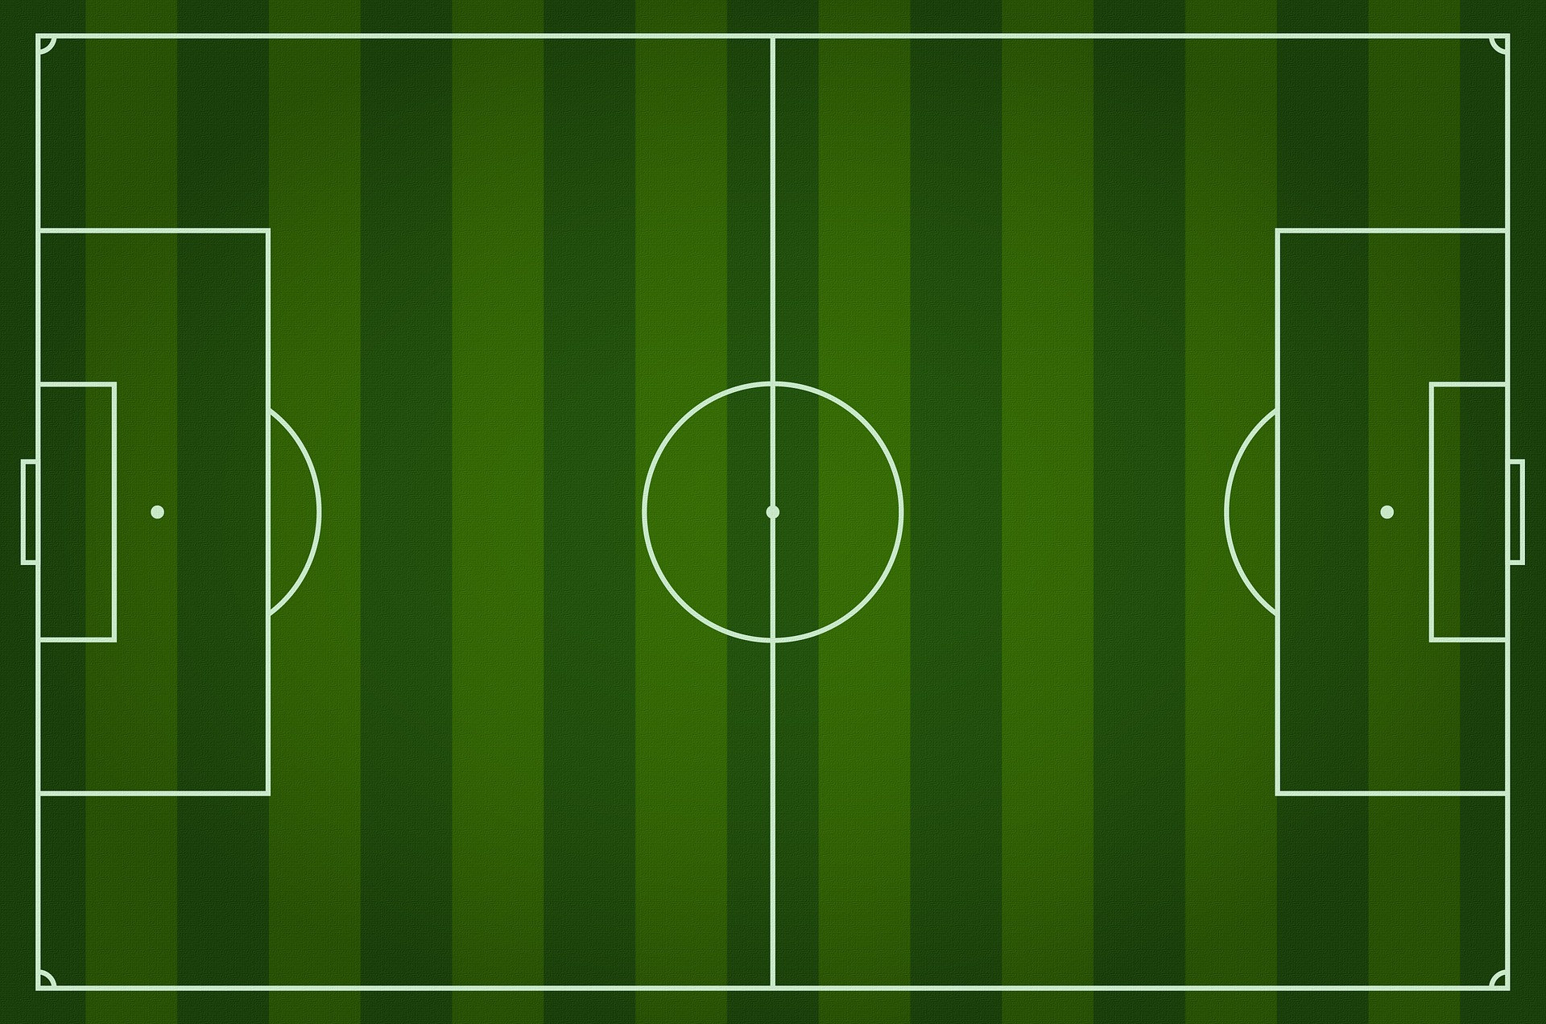
Using a blank sporting ‘field’ design a series of passes to maintain possession in your chosen sport.
How will you show each person?
How will you show movement?
How will you clearly demonstrate your passes?
Name your passes or ‘plays’
Print in B&W | Annotate plays

Slide 7





Basketball Court Diagram click here
Soccer Field Diagram click here
Volleyball Court Diagram click here
Netball Court Diagram click here
Hockey Pitch Diagram click here
AFL Football Field click here
Lacrosse Field Diagram click here
Touch Rugby Field Diagram click here

Slide 8



During you allotted game time, other class members will film you while you test out you designed passes against another group.
How effective were your designed passes in maintaining possession of the ball?
What improvements could you make?
How would you describe your technique?
How well did you work as a team? How well did you communicate?
How well did you work through frustrations?
Did your team attempt to play fairly?
Were you a good sport?

Slide 9


Slide 10
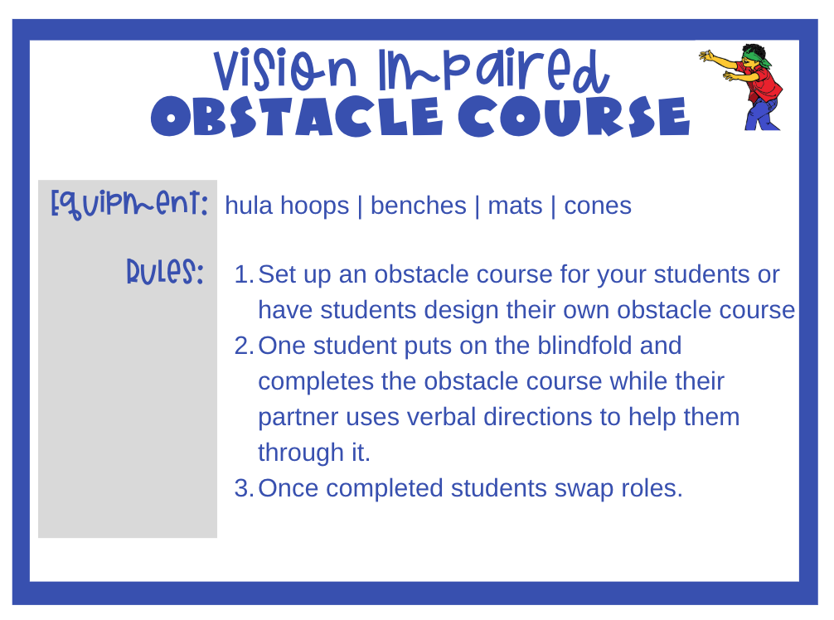

Slide 11
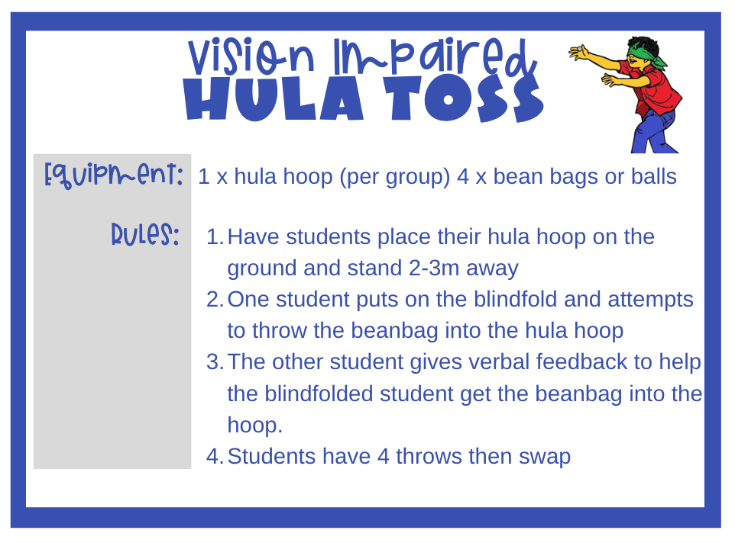

Have Students change the distance of the hula hoop
Have students spin their partner first
Place an extra hula hoop a distance away from the first hula hoop. Students then walk towards the first hoop, pick up the beanbag and then throw from that hula hoop.

Slide 12
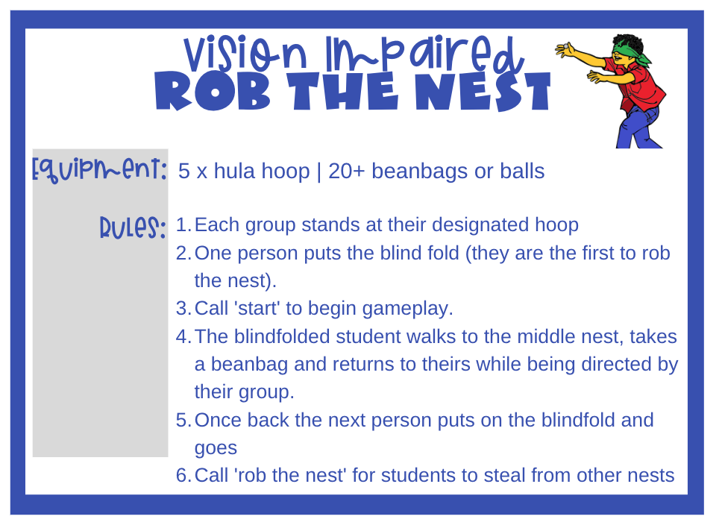


Set up the rob the nest by placing one hula hoop in the middle (place all the beanbags here) then one for each group spaced around the first.
‘Start’ - begin game
‘Rob the nest’ – steal from other groups nests
‘Stop’– finish game
At the end: count up the beanbags and the team with the most wins.

Slide 13

What is the importance of auditory feedback?
What did you learn about giving verbal instructions?
How important is it to give precise instructions?
How can you apply this learning to physical education?

Slide 14

Follow Leasha’s Lessons to keep up to date
Follow on Teachers Pay Teachers
Follow on Facebook
Follow on Instagram
Website

