Slide 1

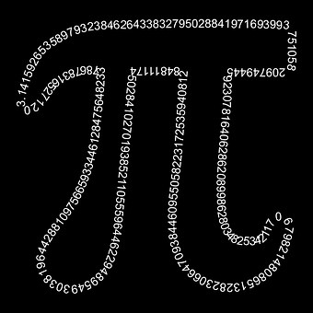

Inquiry Based Learning
Place Value: Decimals
https://www.australiancurriculumlessons.com.au/
By Jen Graham

Slide 2
 | Prior knowledge of the student (assumed) | Level 4 Where the student is currently working | Level 5 Where the student is currently working | Level 6 Where the student is heading
Victorian Curriculum Learning Area Mathematics: Strand Number and Algebra Substrand Fractions and Decimals | Level 2 Recognise, model, represent and order numbers to at least 1000 (VCMNA104 Level 3 Recognise, model, represent and order numbers to at least 10 000 (VCMNA130) | Recognise that the place value system can be extended to tenths and hundredths. Make connections between fractions and decimal notation (VCMNA159) | Recognise that the place value system can be extended beyond hundredths (VCMNA189) Compare, order and represent decimals (VCMNA190) | Add and subtract decimals, with and without digital technologies, and use estimation and rounding to check the reasonableness of answers (VCMNA214) Multiply decimals by whole numbers and perform divisions by non-zero whole numbers where the results are terminating decimals, with and without digital technologies (VCMNA215) Multiply and divide decimals by powers of 10 (VCMNA216) Make connections between equivalent fractions, decimals and percentages (VCMNA217)
Australian Curriculum Learning Area Mathematics: Strand Number and Algebra Substrand Fractions and Decimals | Level 2 Recognise, model, represent and order numbers to at least 1000 (ACMNA027 Level 3 Recognise, model, represent and order numbers to at least 10 000 (ACMNA052 | Recognise that the place value system can be extended to tenths and hundredths. Make connections between fractions and decimal notation (ACMNA079 | Recognise that the place value system can be extended beyond hundredths (ACMNA104 | Add and subtract decimals, with and without digital technologies, and use estimation and rounding to check the reasonableness of answers (ACMNA128 Multiply decimals by whole numbers and perform divisions by non-zero whole numbers where the results are terminating decimals, with and without digital technologies (ACMNA129 Multiply and divide decimals by powers of 10 (ACMNA130 Make connections between equivalent fractions, decimals and percentages (ACMNA131

Slide 3


Learning Intention and Success Criteria
Learning Intention (teacher)
To use inquiry based learning to understand student’s prior knowledge on decimals, reinforce their understanding of whole number place value, introduce/extend their knowledge of decimals and invite them to further investigate decimals based on their own wonderings.
Success Criteria (student)
I am beginning to understand the process of inquiry based learning.
I am actively engaged in my learning by writing ‘I wonder’ questions.
I am able to use a decimat and explain it to others.
I can change fractions (1 / 10 and 1/100) to decimals (0.1 0.01)
I am able to read decimals.
I am able to write decimals.
I can complete a self-assessment on my learning.
I wonder…..
During this unit if you ‘wonder’ about anything write it on a sticky note and we can research your ‘wonderings’ during the Going Further stage.

Slide 4
Inquiry Based Learning Place Value - Decimals
This is an outline of the Inquiry Process Unit: Decimals. Like all inquiry processes, depending on their understandings, which you will find out during Tuning In, may alter the proceeding lessons or questions which may arise during the inquiry process.
Tuning In Pre-Test Number line 1 Number line 2 A decimal is….. Answer and explain 0.42x10= | Finding Out Video Clip Definition Base 10 | Sorting Out Vocabulary/Key Words Word Wall Decimats - introduction Decimats - game
Going Further When would we see or use decimals? Researching Wonder Wall answers | Making Connections Post-Test Self-Assessment Rubric | Taking Action How can we use our knowledge on decimals? Creating ideas and actions to share their knowledge

Slide 5


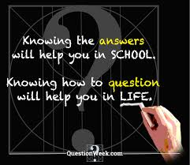
Inquiry Learning Cycle Questions - Tuning In
Summarised from SLAV (School Library Association of Victoria)
You may like to briefly look at all Tuning In questions or focus on one that you refer back to at the end of the unit. For example ask students to draw or write one word to describe how they feel about working with decimals.
What do I know about decimals?
How do I know it?
What experiences do I have with decimals?
What do I want to know?
What ideas am I interested in?
What are my questions?
What am I feeling?
Remember to add your ‘I wonder’ questions about decimals to sticky notes and display on the ‘Wonder Wall’

Slide 6
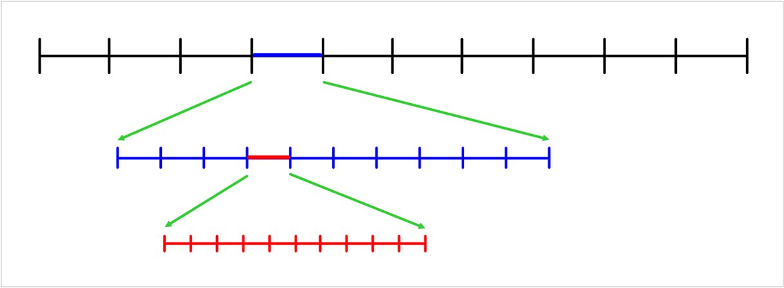
Tuning In (pre-test)
On the first black interval choose a two digit number. Proceed to count by ones along the black intervals. Then fill in the blue intervals then the red intervals.
Image from @CookSaleshni Twitter

Slide 7
Finish this sentence
A decimal is……...

Slide 8
What happens when you multiply a decimal by 10?
0.42 x 10 =
Explain your answer in one of the following ways:
Draw a diagram
Write
Video themselves
***Students can compare their explanations at the end of the unit***
You don’t need to explain the correct answer yet, this will come in the Finding Out section of the inquiry process.

Slide 9
Inquiry Learning Cycle Questions - Finding Out
Summarised from SLAV (School Library Association of Victoria)
Focus on the relevant questions for your group of students.
Where might I go to find more information?
What resources might I use?
What key words could I use in my searches?
Where can I find different points of view on this?
What can I do to learn more?
What are my questions?
How do I know whether my resources are good?
What am I feeling at this phase? Is there anything I can do about the way I feel to be more
successful?
Remember to add your ‘I wonder’ questions about decimals to sticky notes and display on the ‘Wonder Wall’

Slide 10
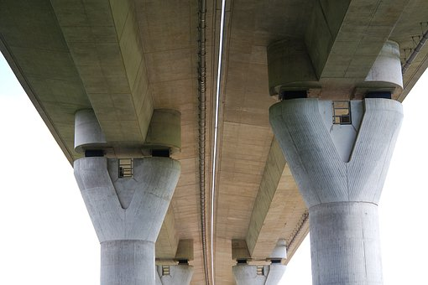

Finding Out
In Mathematics you need a solid understanding or foundation in Place Value before you progress to decimals. This video goes back to basics when you began counting by ones and continues through to now, when you are reinforcing your knowledge on decimals.
https://www.youtube.com/watch?v=KG6ILNOiMgM (12 minutes)
Can we refine our definition of decimal which we
made in the Tuning In section?
If you are brainstorming, the link takes you to a moving
mind map https://www.twinword.com/ideas/graph/ type in decimals in the LSI Graph section.
To confirm whether our definition of decimals is correct - where would we look?
Go and find out…..
Hmmm, I wonder if we could work out the meaning of these words; decade, decathlon and decagon.
What does the base word ‘dec’ mean? Where did it originate?

Slide 11
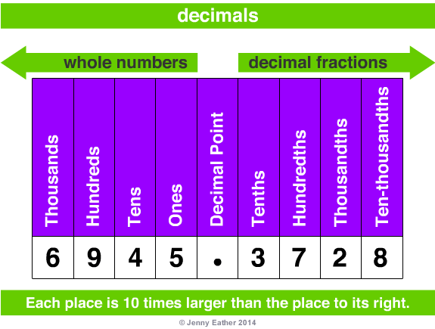
Base 10 System
What do the words ‘Base 10’ mean to you?
Listen to this fun song - does it change your understanding of Base 10?
https://www.youtube.com/watch?v=a4FXl4zb3E4
Place Value definition:
The value of a digit depending on its place or position in a number.
Base-10 system
• our everyday number system is a Base-10 system.
• the Base-10 number system is known as the decimal system
and has 10 digits to show all numbers
0,1,2,3,4,5,6,7,8,9
using place value and a decimal point to separate
whole numbers from decimal fractions.
http://www.amathsdictionaryforkids.com/qr/b/base10system.html

Slide 12
Now you are starting to understand the Base 10 system, try these equations together.
2.0 x 10 =
20.0 x 10 =
200.0 x 10 =
4000.0 ÷ 10 =
400.0 ÷ 10 =
40.0 ÷ 10 =
Discuss answers and whether you could work the answer out automatically.
Now try these
36 ÷ 10 =
72 ÷ 10 =
5.7 ÷ 10 =
18.3 ÷ 10 =
3.2 x 10 =
456.78 x 10 =
What is happening to the decimal point?

Slide 13
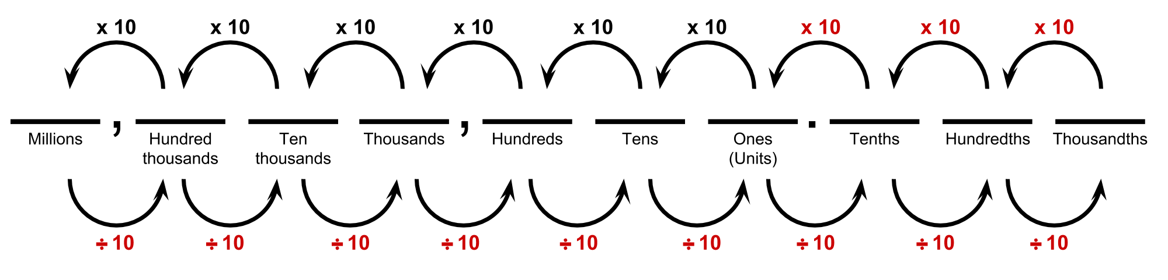
Complete and Explain
When you multiply a number by 10 the number gets …………………………………………. (bigger/smaller) and you move the decimal point one place to the …………………………… (right/left)
Example: 157.36 x 10 =
When you divide a number by 10 the number gets …………………………………………. (bigger/smaller) and you move the decimal point one place to the …………………………… (right/left)
Example: 157.36 ÷ 10 =
Diagram from https://www.cpalms.org/Public/PreviewResourceLesson/Preview/28707

Slide 14
Inquiry Learning Cycle Questions - Sorting Out
Summarised from SLAV (School Library Association of Victoria)
Focus on the relevant questions for your group of students.
How can I sort the information I have found?
What information helps answer my questions and the questions of others?
What key words help me make sense of the information I found?
Do I need to find more information?
How is the information connected to what I already know?
What are my questions now?
How have my questions changed?
What changes do I need to make to my inquiry?
How are my ideas changing? What am I feeling about my inquiry at this phase?
Remember to add your ‘I wonder’ questions about decimals to sticky notes and display on the ‘Wonder Wall’

Slide 15
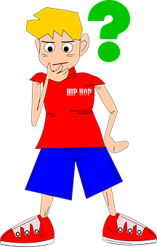
Sorting Out
We have lots of knowledge about decimals now we need to sort it out
to ensure it is clear in our minds. If it is clear it is easier to recall when
asked to work with decimals in the future.
Glossary / Dictionary / Vocabulary Wall
Start / continue a glossary of vocabulary or key words relating to decimals. Write the meanings in ways you understand for example you may like to draw a diagram or take a photo which may help you with remembering the meanings.
Some key words you may like to add to your glossary
decimal
tenths, hundredths, thousandths
whole
fraction
decimal point
number line
interval
order - smallest / largest
compare
place value
An example of a Maths Dictionary http://www.amathsdictionaryforkids.com/qr/d/decimal.html

Slide 16
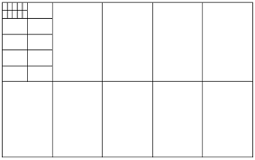
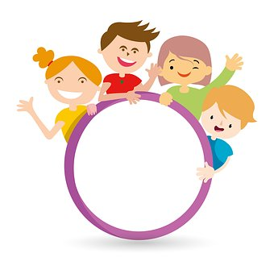
Deci-Mats
Give students a copy of deci-mats (available here-laminate if possible)
http://calc.amsi.org.au/wp-content/uploads/sites/15/2017/12/decimats-template.pdf
https://nzmaths.co.nz/sites/default/files/Numeracy/2007matmas/Bk7/MM%207_3.pdf
Use the PowerPoint of how to use deci-mats or give your own
explanation. (For the PowerPoint click on link and go to the green box at the bottom labelled Decimats Introduction.https://calculate.org.au/2017/12/05/decimats/
Allow students to play the decimats board game - on the above website
Teacher background on deci-mats
https://calculate.org.au/2017/12/05/decimats/
https://files.eric.ed.gov/fulltext/EJ891799.pdf
Encourage students when playing to use the correct terminology by saying
0.42 as 42 hundredths
and not zero point four two

Slide 17
Sorting Out
Reinforcing skills
Online games are free however a lot of advertisements and links to other sites - ensure students understand cyber safety if working independently.
https://www.interactivestuff.org/sums4fun/decchall.html
https://www.splashmath.com/decimal-games-for-4th-graders
https://www.mathplayground.com/index_fractions.html
http://www.sheppardsoftware.com/mathgames/decimals.htm
http://www.math-play.com/decimal-math-games.html
https://www.topmarks.co.uk/maths-games/7-11-years/fractions-and-decimals
https://au.ixl.com/?partner=google&campaign=58810025&adGroup=2284775225&gclid=CjwKCAjwxt_tBRAXEiwAENY8hfR7GKbW0VKUbz9RAllgRb9cy0MjDgZjgmxIQHzPdhi_XhaJmtfhOxoCTsAQAvD_BwE
Paid subscriptions
Mathletics

Slide 18
Inquiry Learning Cycle Questions - Going Further
Summarised from SLAV (School Library Association of Victoria)
Focus on the relevant questions for your group of students.
What information do I wish to share?
Who will be my audience?
Are all my questions answered?
Have I considered the different points of view on this topic?
Have I found enough information?
How can I plan to show the connections I have made?
What am I feeling about showing what I have learned?
Remember to add your ‘I wonder’ questions about decimals to sticky notes and display on the ‘Wonder Wall’

Slide 19

Going Further
But why is learning about decimals so important?
Where would I use this in real life? Does it matter if I don’t know the difference between 0.05 and 0.50?
Research, discuss and share where you would see or use decimals in real life.

Slide 20

This may or may not fit into your student’s inquiry
Ordering decimals with real life planet size https://www.youtube.com/watch?v=xKYh1yjdxbo
Going Further
Have you researched and answered all your ‘I wonder’ sticky notes from the Wonder Wall?
Have you shared what you have found?

Slide 21
Inquiry Learning Cycle Questions - Making Conclusions
Summarised from SLAV (School Library Association of Victoria)
Focus on the relevant questions for your group of students.
What do I now understand about decimals?
Have I shared what I have learned with others effectively?
Did I answer all my questions?
What am I going to do now with what I have learned?
What would I do differently?
How do I feel about the way I shared my learning?
How do I feel about what others’ thought?

Slide 22
Post Test
What do I now know about decimals?
Complete the ‘Tuning In’ assessment sheet again which features the following three sections:
A decimal is……
0.42 x 10 = Explain your answer.
Complete the diagram below.

Slide 23

Compare your knowledge from your Tuning In test to now.
What has been your biggest improvement?
What do you still need to learn?
What was your biggest challenge?
What are you proud of?

Slide 24
Self-Assessment Rubric - Place Value
Student’s Name………………………………………….. Date …………………………………………………..
 | Level One | Level Two | Level Three | Level Four | Level Five
Reading | I can read numbers to at least 100 | I can read numbers to at least 1000 | I can read numbers to at least 10 000 | I can read numbers to the hundredths | I can read numbers beyond hundredths
Writing | I can write numbers to at least 100 | I can write numbers to at least 1000 | I can write numbers to at least 10 000 | I can write numbers to the hundredths | I can write numbers beyond hundredths
Modelling | I can model numbers to at least 100 | I can model numbers to at least 1000 | I can model numbers to at least 10 000 | I can model numbers to the hundredths | I can model numbers beyond hundredths
Recognise value of digit | I can recognise the value of all digits in a whole number to at least 99 | I can recognise the value of all digits in a whole number to at least 999 | I can recognise the value of all digits in a whole number to at least 999 | I can recognise the value of decimals to at least hundredths | I can recognise the value of decimals beyond hundredths
Australian Curriculum | Recognise, model, read, write and order numbers to at least 100. Locate these numbers on a number line (ACMNA013 | Recognise, model, represent and order numbers to at least 1000 (ACMNA027 | Recognise, model, represent and order numbers to at least 10 000 (ACMNA052 | Recognise that the place value system can be extended to tenths and hundredths. | Recognise that the place value system can be extended beyond hundredths (ACMNA104

Slide 25
Inquiry Learning Cycle Questions - Taking Action
Summarised from SLAV (School Library Association of Victoria)
Focus on the relevant questions for your group of students.
How can what I learned help me in my learning life or help others?
How can I improve my learning?
How did I learn best?
How am I going to take action to improve my learning?
How am I going to use what I learned to take action and make a difference?
How will my actions affect others?
What was the highlight of this inquiry?
How have my feelings changed throughout this inquiry process?
From what I have learned, what do I feel most passionare about?

Slide 26
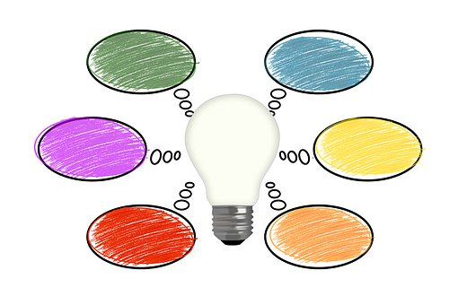

How can YOU share or use what you have learned during this inquiry process?
Remember to share your ideas, have-a-go at thinking regardless of how small or
different the idea may seem.

Slide 27

Ideas which may come from your students
Create a PowerPoint explaining decimals
Write an article for the school newsletter on decimals
Teach younger students (or levels) the decimats game
Create an assembly item about decimals
Design a poster with information about decimals
Have a parent versus student decimat game
Create a video explaining decimals which can be shared (cyber safety awareness)
Teach younger students (levels) about decimals
Cook something, buy something, measure something using decimals
………..

Slide 28

Thanks for using this PowerPoint on inquiry based learning with decimals. Please head to https://www.australiancurriculumlessons.com.au/ for more free lessons aligned to the Australian Curriculum.
PowerPoint created by Jen Graham.

