Slide 1


Data Representation and Interpretation
Years One and Two
Australian Curriculum Lessons
By Jen Graham

Slide 2

Australian Curriculum Outcomes
Learning Area: Mathematics
Strand: Statistics and Probability
Substrand: Data representation and interpretation
Level One
Choose simple questions and gather responses and make simple inferences (ACMSP262 - Scootle )
Represent data with objects and drawings where one object or drawing represents one data value. Describe the displays (ACMSP263 - Scootle )
Level Two
Identify a question of interest based on one categorical variable. Gather data relevant to the question (ACMSP048 - Scootle )
Collect, check and classify data (ACMSP049 - Scootle )
Create displays of data using lists, table and picture graphs and interpret them (ACMSP050 - Scootle )

Slide 3

Lesson Progression
Slide One - Title
Slide Two - Australian Curriculum
Slide Three - Lesson Progression
Slide Four - Tuning In
Slide Five - Record thinking - pre-assessment
Slide Six - Definition of data
Slide Seven - Missing Information
Slide Eight - Data Collection - pictograph
Slide Nine - Data Collection - bar graph
Slide Ten - Vocabulary
Slide Eleven - Tally Marks
Slide Twelve - Interpreting Tally Marks
Slide Thirteen - Post Assessment

Slide 4
Tuning In - Think, Share, Pair
Tell us everything you can about this image.

Slide 5
Pre-Assessment: What do you know?
Think, Pair, Share, Square - Group 1
Think, Pair, Share, Square - Group 2
Think, Pair, Share, Square - Group 3
Think, Pair, Share, Square - Group 4
Think, Pair, Share, Square - Group 5

Slide 6
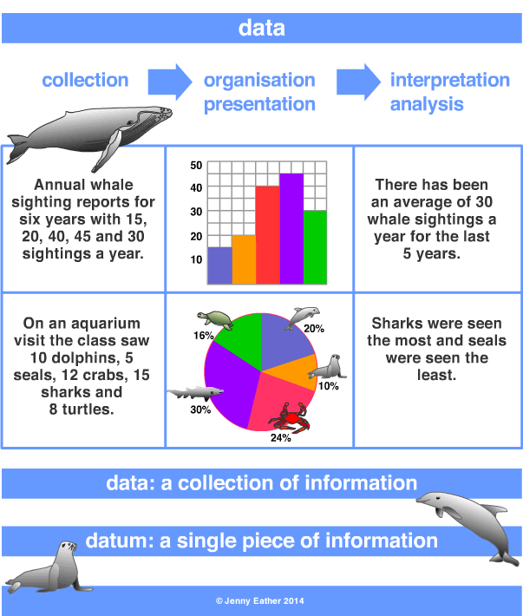
data
• data is a collection of information
gathered by observation, questioning or measurement.
• data is often organised in graphs or charts for analysis and
may include facts, numbers or measurements.
From Jenny Eather
http://www.amathsdictionaryforkids.com/qr/d/data.html

Slide 7
What was missing from this graph below to help us understand (interpret) the data that was collected?

Slide 8

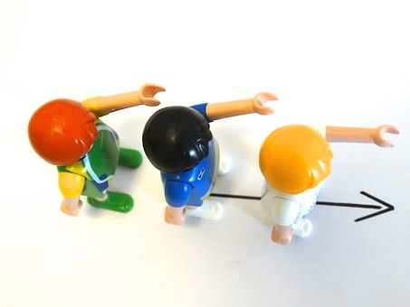

Pictograph with Students
What month were you born?
Line up in a single file in the months you were born.
Ensure lines are straight and you can see all students.
Take a photo and upload to a TV or computer that all students can see.

Slide 9
Birth Months.
An example of what your graph may look like.
7
6
5
4
3
2
1
 | Jan | Feb | Mar | Apr | May | Jun | Jul | Aug | Sep | Oct | Nov | Dec
Key: 1 square = 1 student

Slide 10
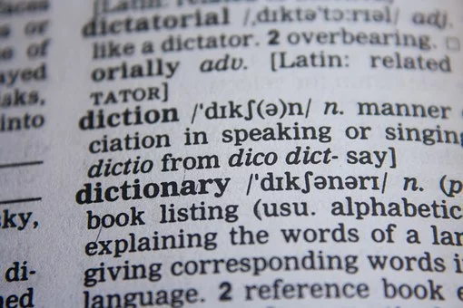
Vocabulary
In small groups with a small whiteboard and a whiteboard marker (or paper and pencil) ask students to draw or write their definition of the following words:
tally question count
table survey
bar graph
pictograph
Discuss words once students have shared their definition and click on hyperlinks for more information.

Slide 11
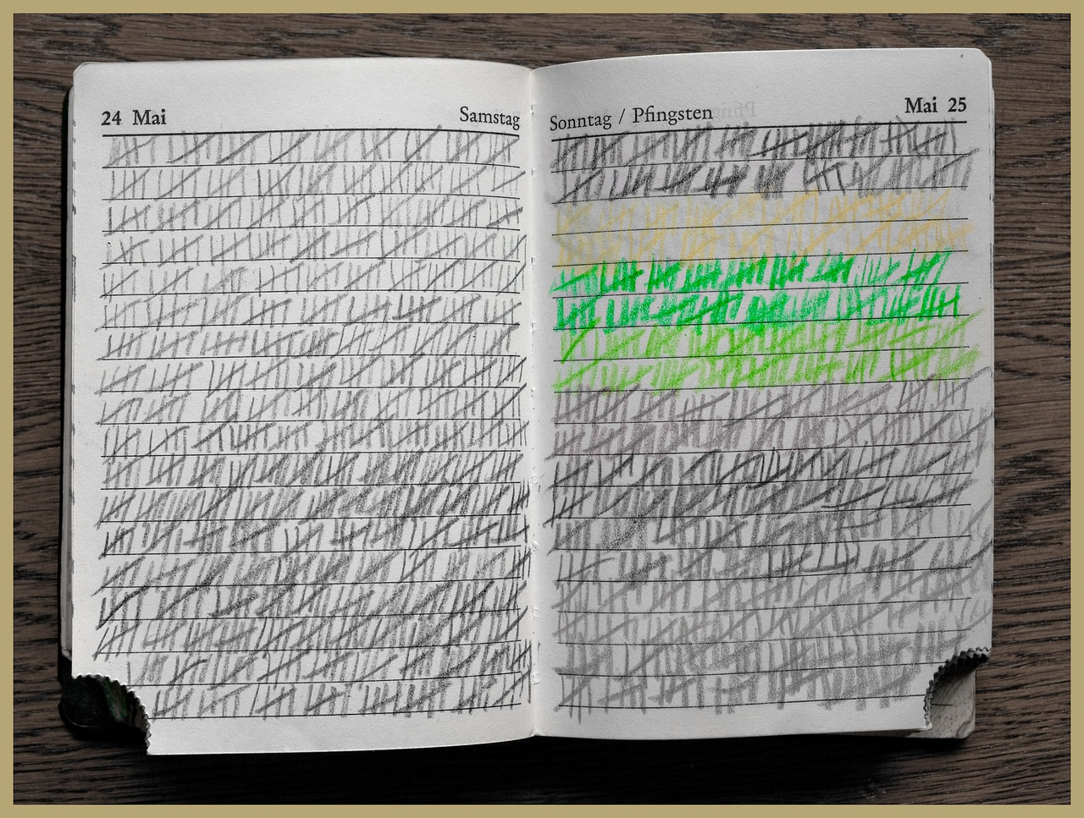
What are tally marks?
Why are they useful?
Using the tally marks on the next slide, what information can we gain?
How do tally marks make
understanding information
easier?
Tally Marks

Slide 12




Our Class’ Favourite Dessert
Ice-cream
Apple pie
Custard
Yogurt

Slide 13
Task - Tally Marks
Use tally marks to ask the students in your class one of the following questions or a question of your own. Make sure there are not too many options for the answers.
What is your favourite pet?
Do you have a jack russell?
What is your favourite AFL team?
What is your favourite sort of writing; persuasive, informative or imaginative?
What is your favourite take-away?
What ice-cream flavour do you like the best?
What is your favourite animal?
What is your favourite dog?
What is your favourite thing to do at lunchtime at school?

Slide 14


From the data collected (tally marks) interpret the results and share your findings with the class.
Can you represent this data as a graph?

Slide 15
Post Assessment - Think, Share, Pair
Look at your pre-assessment (slide 5). What information can you add about this graph? Can you add any new vocabulary to your ideas?

