Slide 1


Slide 2

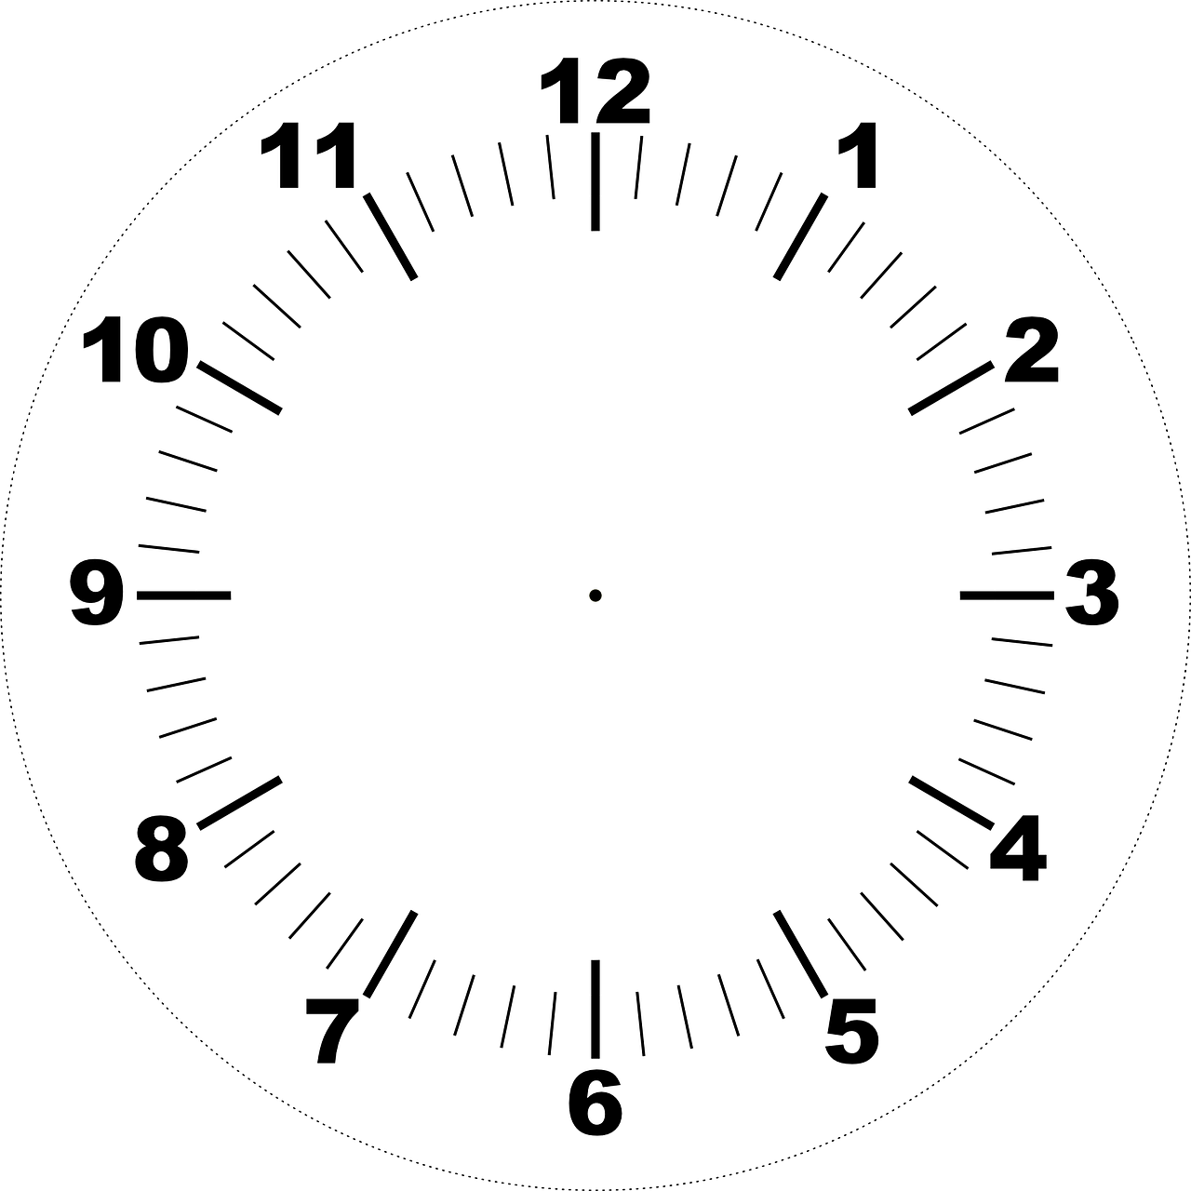
Time is told in 12 hours
We use AM and PM to show whether it is morning or afternoon
AM = Ante Meridiem
PM = Post Meridiem

Slide 3

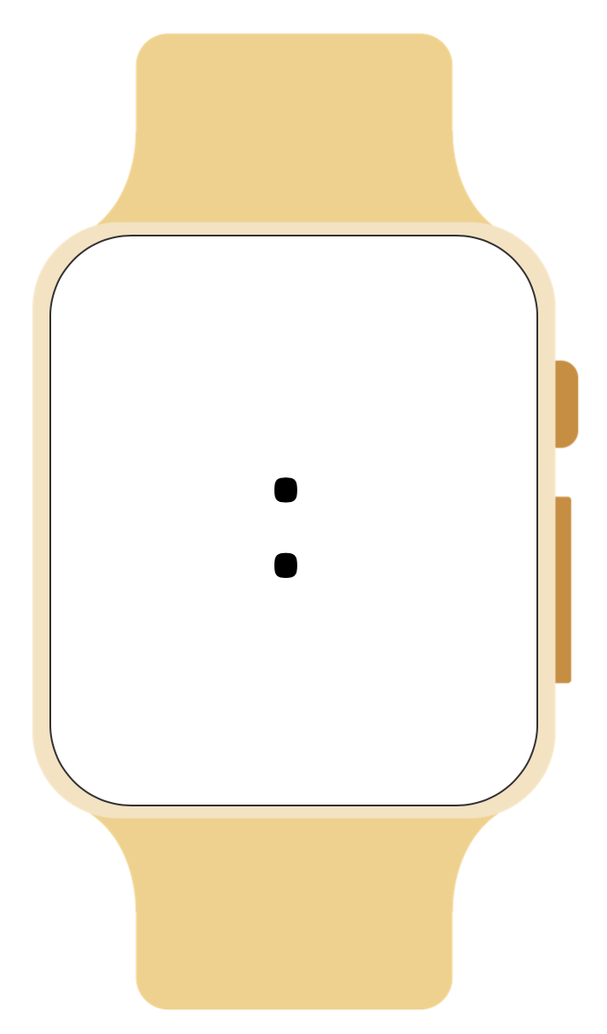
Time is told in 24 hours
We use the numbers 0:00 – 24:00 to show whether it is morning or afternoon
Written in hours: minutes
Known as military time

Slide 4

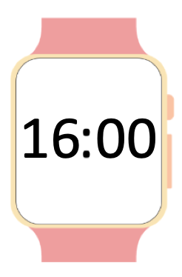
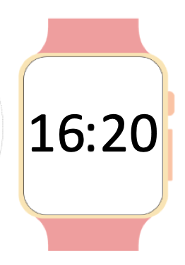
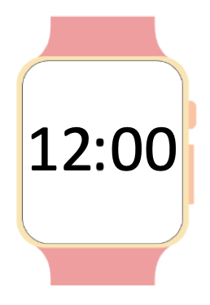
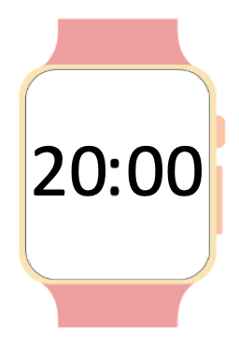
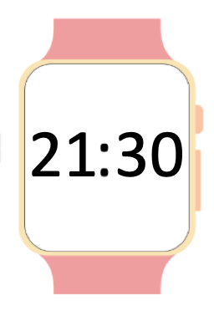
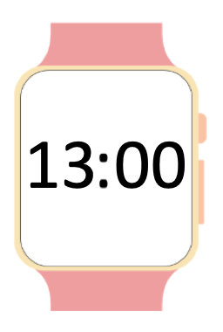

Slide 9

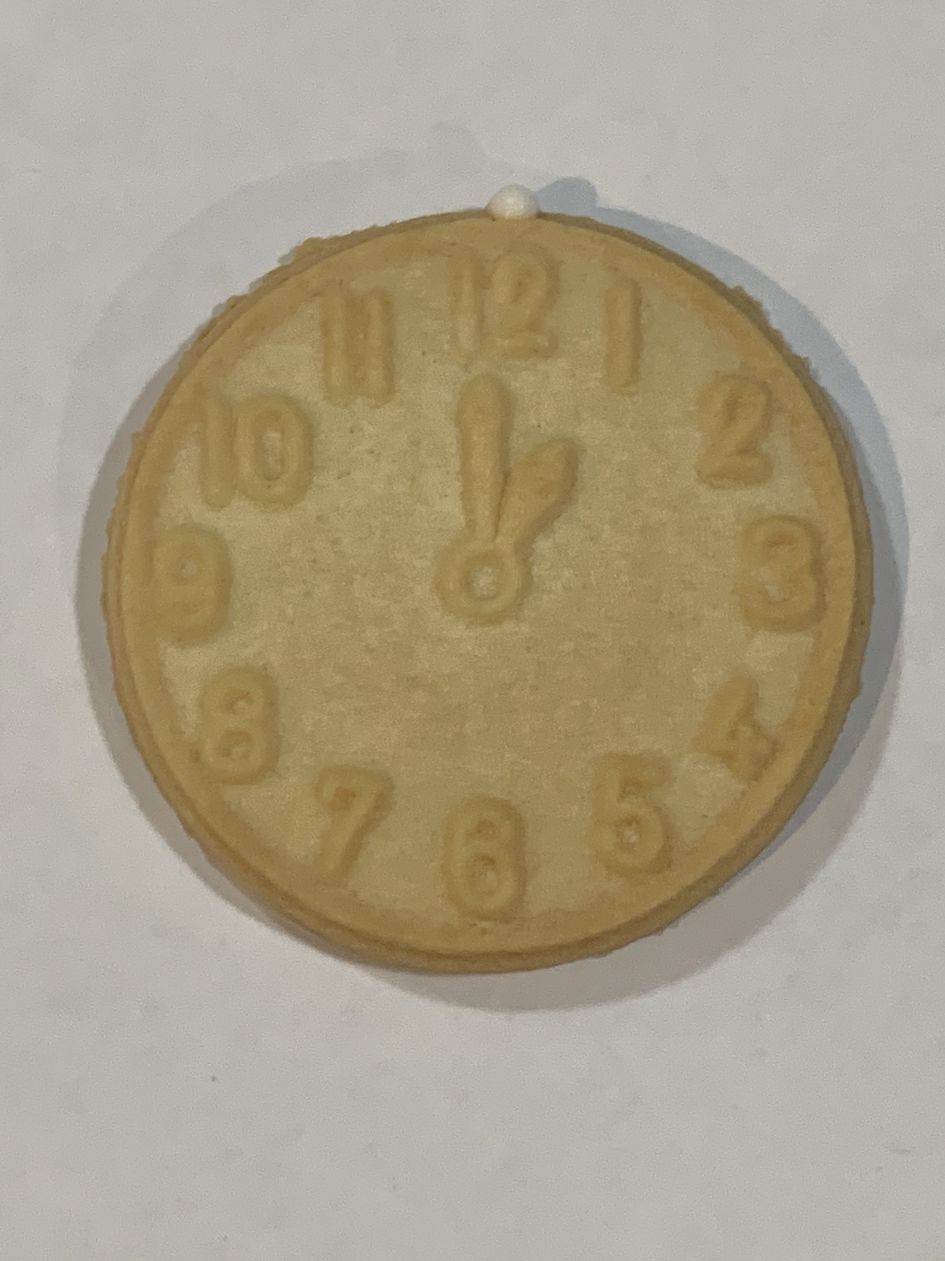
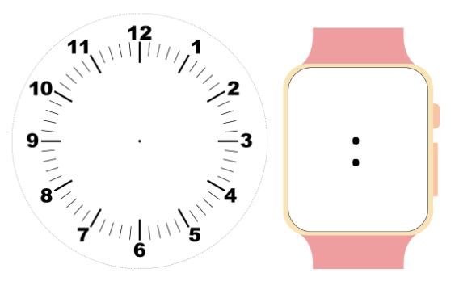
Choose a Tic Toc biscuit
Copy the time onto the clock
Write the 24 hour time on the smart watch
Repeat
13
00

Slide 10

Follow Leasha’s Lessons to keep up to date
Follow on Instagram
Share your work and tag @leashaslessons

Slide 11

Credits
BoyBearDesigns
Digital Clipart
Etsy

