Slide 1
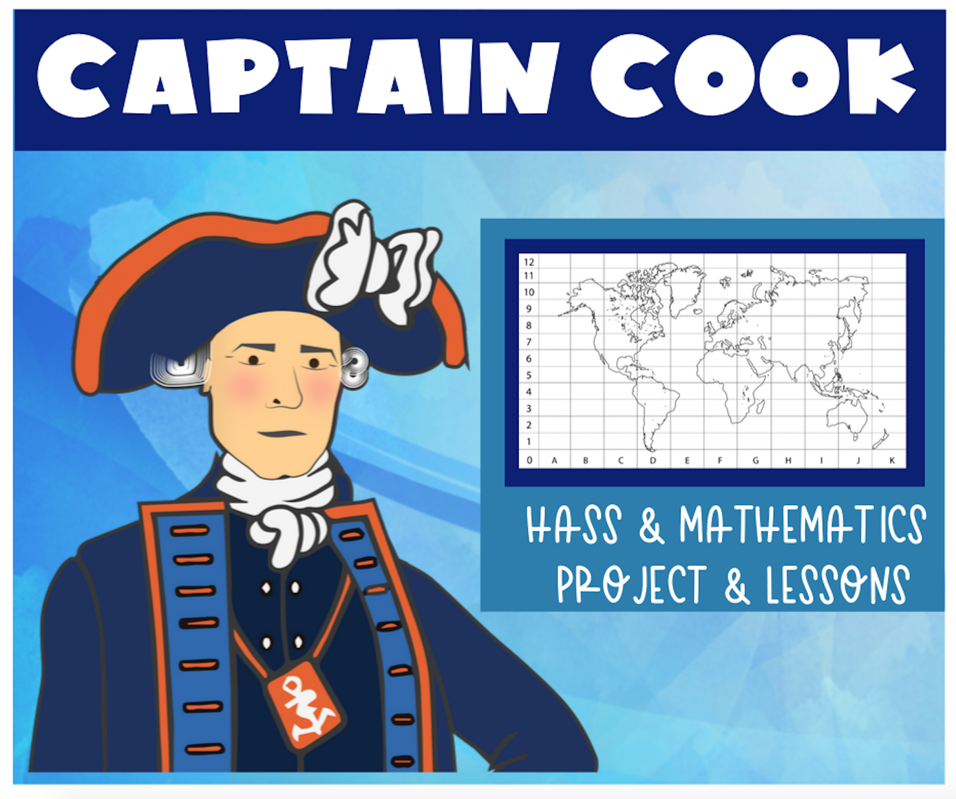

Slide 2

Who was Captain Cook?
What do we already know?
What do we want to find out?
Brainstorm as many questions we can think of about Captain Cook.

Slide 3

Demonstrate your understanding of Captain Cook's voyage to Australia by creating;
Part 1: Captain Cook Voyage Map
Part 2: Timeline of events
Part 3: Ship Measurements and comparison

Slide 4

Create a map demonstrating the journey Captain Cook took to Australia using a grid reference system.
Mapping Features
Grid reference system and identified coordinates
Scale
Legend
Labelled continents
Clear path of the voyage
Identified coordinates
You need to mark key places on your map from Captain Cook’s journey and record the coordinated. For example: *place name* at D6

Slide 5
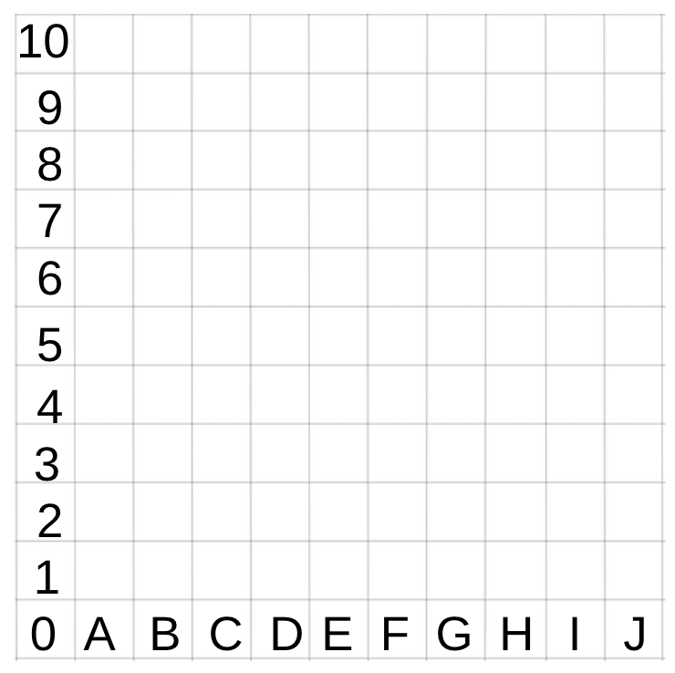


J10
E9
B6
I5
E4
A3
G2

Slide 6

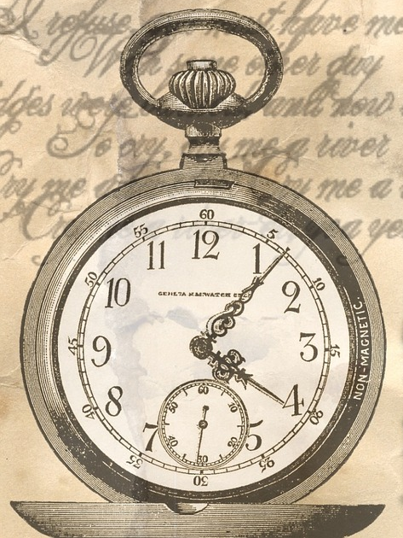
Create a timeline demonstrating the key dates from Captain Cook’s journey to Australia.
Timeline inclusions:
Events are clearly dated and in correct time order
Clearly demonstrates the journey Captain Cook took to Australia
Demonstrates all stops and points of interest

Slide 7

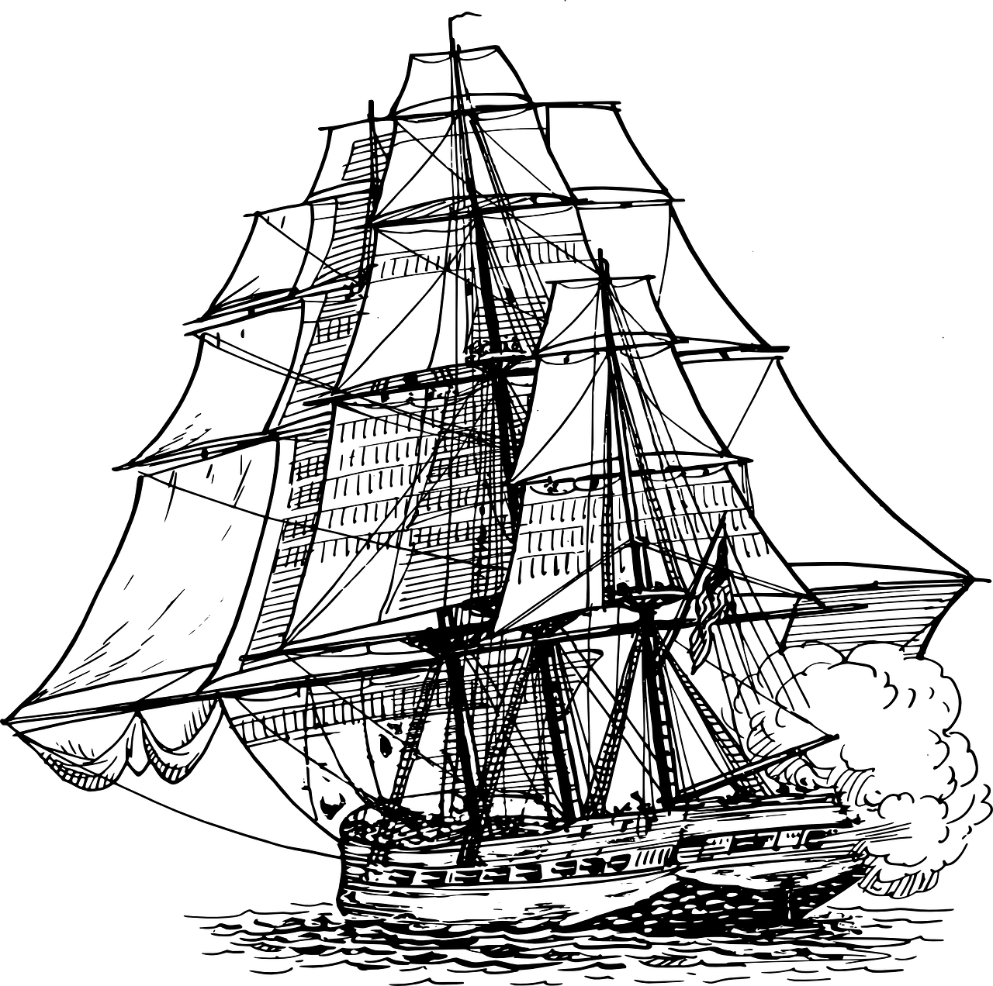
Created a scaled version of the HMB Endeavour which was used for Captain Cook’s voyage.
Ship inclusions:
Create a scale for the ship (e.g. 5mm = 1m)
Must be drawn neatly in pencil and use a ruler
Demonstrate accurate measurements of the real ship
Include some facts

Slide 8

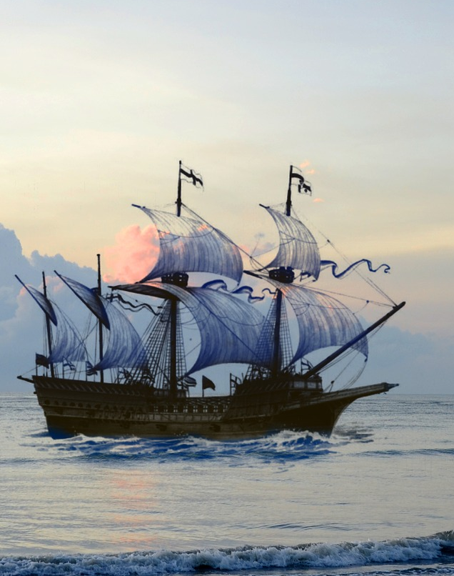
Compare the ship with another famous ship used in a voyage to Australia (e.g. First Fleet Ships).
Comparisons:
Create a scaled drawing of your chosen ship
How are the ships similar?
How are they different?
Fact file: Find some interesting facts about both of the ships to compare

Slide 9

Follow Leasha’s Lessons to keep up to date
Follow on Instagram

