Slide 1

CHANGING
NATIONS
THE POPULATION SHIFT
Notes:
Begin by playing the attached PowerPoint, when you reach the second slide discuss with students what they think a Megacity might be.

Slide 2
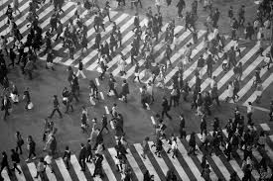
URBANISATION
The increase of the population density in Urban Areas.
As rural populations decrease more and more people are moving to cities.
Notes:
Read through and discuss.

Slide 3

MEGACITIES
THE WORLD IS CHANGING, MEGACITIES ARE ON THE RISE.
Notes:
Continue reading through the slides and engaging the students, it is suggested that students take brief do point notes of the slides.

Slide 4
WHAT IS A MEGACITY?
A megacity is a city with a population exceeding 10 million
There are currently 35 megacities in the World
80% of the worlds megacities are in Asia
Notes:
Continue reading through the slides and engaging the students, it is suggested that students take brief do point notes of the slides.

Slide 5
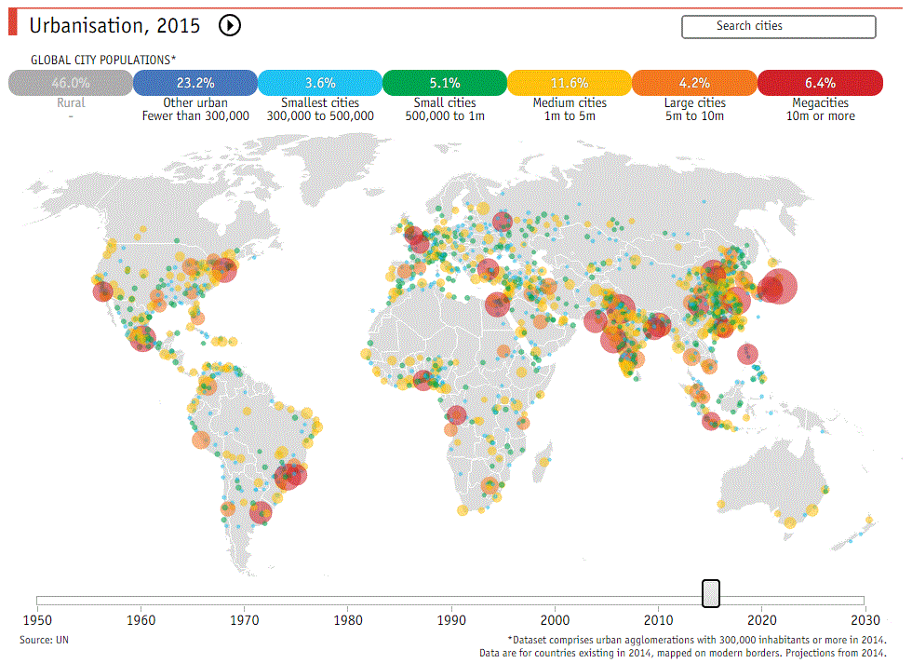
Notes:
Continue reading through the slides and engaging the students, it is suggested that students take brief do point notes of the slides.

Slide 6
HOW DO YOU POSSIBLY MANAGE A CITY OF SO MANY PEOPLE?
CITIES ARE DIVIDED INTO 5 MAJOR AREAS
Notes:
Continue reading through the slides and engaging the students, it is suggested that students take brief do point notes of the slides.

Slide 7
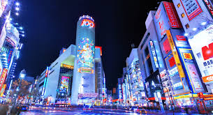
CENTRAL BUSINESS DISTRICT (CBD)
The central business district is usually the most established and accessible section of any city. The fierce competition for sparse land in these areas means the cost of real-estate is much higher in this part of the city.
Notes:
Continue reading through the slides and engaging the students, it is suggested that students take brief do point notes of the slides.

Slide 8
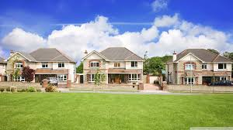
RESIDENTIAL AREAS
Residential areas account for the majority of land use in a city. The areas are used for accommodation but also services and facilities such as, schools & hospitals, for residents in the area.
Notes:
Continue reading through the slides and engaging the students, it is suggested that students take brief do point notes of the slides.

Slide 9
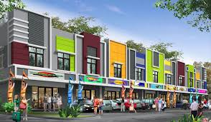
COMMERCIAL AREAS
Commercial areas of a city are generally located on very accessible road networks. Commercial areas are home to shopping centres, malls and businesses.
Notes:
Continue reading through the slides and engaging the students, it is suggested that students take brief do point notes of the slides.

Slide 10
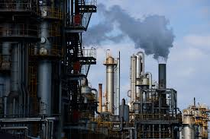
INDUSTRIAL AREAS
Industrial areas are usually located close major transport links such as rail lines, ports & freeways. They are home to factories, warehouses & mills. Industrial areas are located as far away from residential areas as they possibly can be.
Notes:
Continue reading through the slides and engaging the students, it is suggested that students take brief do point notes of the slides.

Slide 11
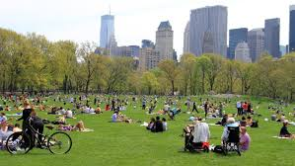
PARKLAND & NATURE AREAS
Parkland Areas in cities are essential in providing a appropriate area for recreational and sporting activities. They also maintain a healthy population of native plats and animals in the area.
Notes:
Continue reading through the slides and engaging the students, it is suggested that students take brief do point notes of the slides.

Slide 12

BUT WHAT IF THE CITY BECOMES TOO BIG
There are several techniques used by development planners too organize how cities will grow & accommodate for their growing populations.
Notes:
Continue reading through the slides and engaging the students, it is suggested that students take brief do point notes of the slides.

Slide 13
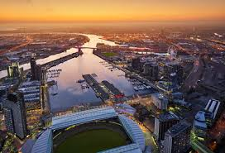
SUBURBANISATION
Developing new housing estates, further away from the Central Business District. As the name suggests this involves creating new suburbs on farmland or underused areas.
Docklands is an example of suburbanisation.
Notes:
Continue reading through the slides and engaging the students, it is suggested that students take brief do point notes of the slides.

Slide 14
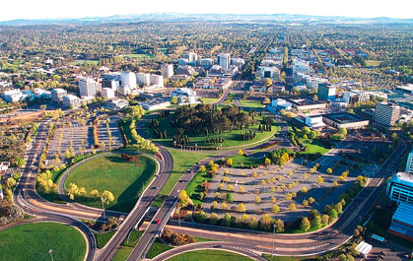
DECENTRALIZATION
Encouraging the growth of regional and suburban economies by introducing more career and entrepreneurial opportunities to such areas.
Canberra is an example of a decentralized City
Notes:
Continue reading through the slides and engaging the students, it is suggested that students take brief do point notes of the slides.

Slide 15
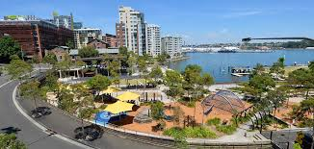
URBAN RENEWAL
Urban renewal is the process of redeveloping underused parts of a city to create new, modern buildings.
Pyrmont-Ultimo, Sydney is an example of a city which has undergone urban renewal
Notes:
Continue reading through the slides and engaging the students, it is suggested that students take brief do point notes of the slides.

Slide 16
WORKSHEETS :)
Make sure you practice good investigative skills, find out the information and convey it in a clear, cohesive and articulate way a good example of this is the peel structure.
Notes:
stop and distribute the worksheets

Slide 17
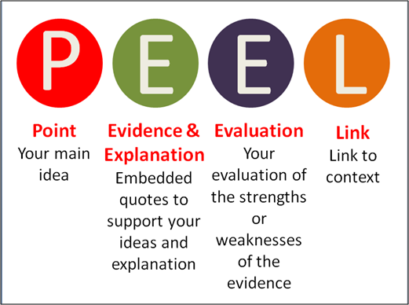
Notes:
slide 18 discusses the Peel structure, however you scan skip this.
The worksheet is sectioned so that you can have the class work through it together or let everyone work at their individual pace & discuss the content.
Allow students to compare answers with their peers, this will help them view the topics they wrote about in a new perspective.
As students to give short feedback on each other works e.g. (“You gave very clear and concise definitions, that was great. You could improve on the way you concluded your last paragraph by linking it to your topic sentence more.”)
If you have any excess time allow students to share their work with multiple peers.

Slide 18
CONGRATULATIONS YOU’VE COMPLETED THE LESSON !
Notes:
Show this to students once they’ve completed the lesson

