Slide 1

THE POWER OF THE PEN
CREATING AND EVOCATIVE TEXTS
Notes:
Stop the PowerPoint here as you Ask students to write down the name of a text which has had a large emotional impact on them (Sadness, anger, happiness etc.)

Slide 2

WHAT ARE LITERARY DEVICES?
Techniques used by writers to create a specific effect in a text.
Enhance emotive impact.
Deeply engage the reader.
Notes:
To gauge how much your students already know about literary devices, you can stop here to discuss these three dot points.

Slide 3
LITERARY DEVICES
EXAMPLES
An analogy is a comparison in which an idea or a thing is compared to another thing that is quite different from it.
Notes:
SUGGESTION: After reading the definition, ask students if they can think of an example quickly. This ensure there listening and can understand the basis of these techniques.

Slide 4
LITERARY DEVICES
A cacophony in literature refers to the use of words and phrases that imply strong, harsh sounds.
Notes:
SUGGESTION: After reading the definition, ask students if they can think of an example quickly. This ensure there listening and can understand the basis of these techniques.

Slide 5
LITERARY DEVICES
Litotes are figures of rhetoric speech that use an understated statement of an affirmative by using a negative description.
Notes:
SUGGESTION: After reading the definition, ask students if they can think of an example quickly. This ensure there listening and can understand the basis of these techniques.

Slide 6
ADVANCED DEVICES
Anthropomorphism - the act of lending a human quality, emotion or ambition to a non-human object or being.
Notes:
SUGGESTION: After reading the definition, ask students if they can think of an example quickly. This ensure there listening and can understand the basis of these techniques.

Slide 7
ADVANCED DEVICES
Diction - the distinctive tone or tenor of an author’s writing, including the mood, attitude, dialect and style of writing.
Notes:
SUGGESTION: After reading the definition, ask students if they can think of an example quickly. This ensure there listening and can understand the basis of these techniques.

Slide 8

GOALS FOR THIS LESSON
UNDERSTANDING WHAT LITERARY DEVICES ARE.
BEING ABLE TO USE LITERARY DEVICES PROPERLY.
BEING ABLE TO USE ADVANCED LITERARY DEVICES CREATIVELY.
WRITNG YOUR OWN IMPACTFUL TEXT!
GIVING AND RECEIVING FEEDBACK.
Notes:
Letting your students know what they should expect to get from this lesson gives everything they do from this point greater purpose.

Slide 9
LET’S START WITH LANGUAGE CHOICES :)
Notes:
The next slide has Audio so make sure you speakers are connected.

Slide 10
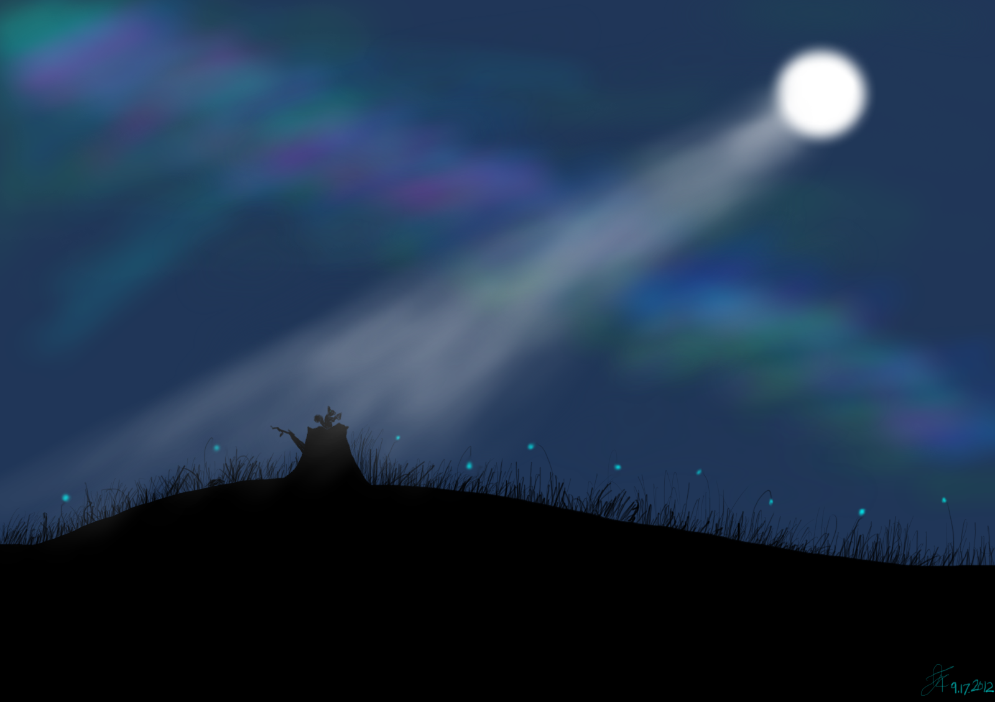
He walked along the quiet, leaf ridden road. The night was cold and mostly dark, with the exception of the occasional ray of moonlight shining on the street. He was afraid to turn around for fear that beast might have been be lurking behind him.
OR
Beneath an eerie splintered moonlight he paced the haunting streets. The road was littered with amber leaves that crunched beneath him and a sinister feel pervaded the air, further evidence the beast was near.
Notes:
Discuss the differences between the two paragraphs, ask students to give reasons for as to why the second one is more descriptive. (the phrases have ben colour coded to show similarities between the paragraphs & how they’ve been reworded.) Discuss the use of language choices and imagery in the second paragraph vs the short lack-lustre words used in the first one.

Slide 11
HOW TO WRITE YOUR IMPACTFUL TEXT

Slide 12

SETTING A VIVID SCENE
The basis of any evocative text is a very well established setting. This is the first introduction the reader has to the tone and style of your writing. A strong and engaging foundation, will guarantee an immediate effect on the reader.

Slide 13

CHARACTERIZATION
If you’re writing a text that includes characters it’s important to really think about how it is you introduce & describe them to your audience.
The use of literary devices to create strong, relatable characters makes events the endure throughout a narrative so much more impactful.

Slide 14
IMPLIED CHARACTERIZATION
Sometimes it’s better to show your audience rather than tell them. For example droning on about the personality of a character like this “He was an angry, sad and mean man who didn’t like talking to anyone. He was short and had green hair that was long and fell onto his shoulders.” is very effective in turning the reader off your writing. A better technique is to display the characters personality, by having them react in a particular when faced with a problem or event.

Slide 15

TENSION
To maintain the brevity and excitement in tense parts of a story, the use of concise but descriptive language is needed.

Slide 16
TENSION
A deep, permeating fear consumed every capillary and cell in her body; fiercely filling her heart with a lachrymose kind of weepy remorse and foreboding for what gargantuan abyss presented its menacing self before her.
WOAHHHHHHHHHHHGSGFD
#WAYTOODISCRIPTIVE

Slide 17
TENSION
In that moment Kaya felt nothing but a spine splintering fear. She launched herself over the gaping abyss, clawing relentlessly at the air, battling to make it over.
#MUCHBETTAAAA

Slide 18
TOO MUCH DESCRIPTION
IS EVEN WORSE THAN TOO LITTLE!
It’s turns the reader off your writing. Often adding a detached tone to the text.

Slide 19
TIME FOR THE WORKSHEET!
Notes:
Distribute the worksheets to students. Or email them an electronic copy. Allow the students to work through them for however long you feel necessary. If some students feel more comfortable typing their impactful text that is ok too.

Slide 20

FEEDBACK TIME
It’s now time to give feedback. When you receive your classmates story write down what is was you liked and thought they could improve. Don’t write your name.
Notes:
Ask students to pass their work three people to the right and give feedback on the sheet they receive. Do this a couple of times before asking each student to collect their sheets and review the feedback they received.

Slide 21
CONGRATULATIONS YOU COMPLETED THE GOALS
UNDERSTANDING WHAT LITERARY DEVICES ARE.
BEING ABLE TO USE LITERARY DEVICES PROPERLY.
BEING ABLE TO USE ADVANCED LITERARY DEVICES CREATIVELY.
WRITNG YOUR OWN IMPACTFUL TEXT!
GIVING AND RECEIVING FEEDBACK.
Notes:
Show this to the students after they have completed all the tasks.

