Slide 1
Country and Rural
Landscapes and Features

Slide 2
Country and Rural
Rural means like or similar to the country side.
Pasture
Grass land
Farms
Fields
Pastoral
Paddocks

Slide 3
Country and Rural
Look at these country scenes. What do you notice about natural and man-made features?

Slide 4
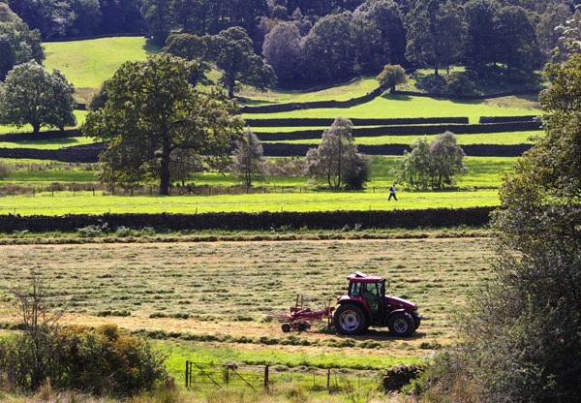

Slide 5
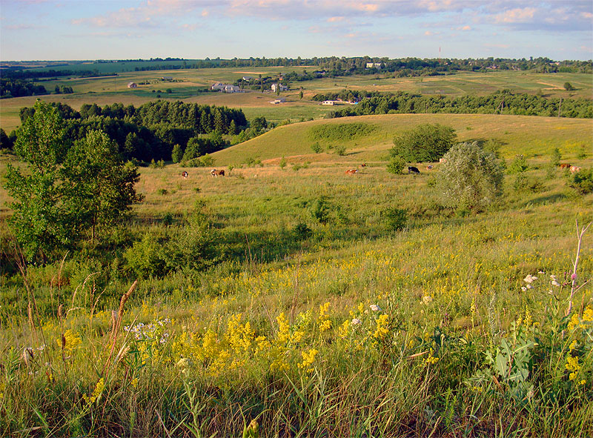

Slide 6
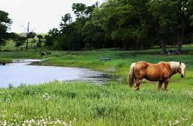

Slide 7
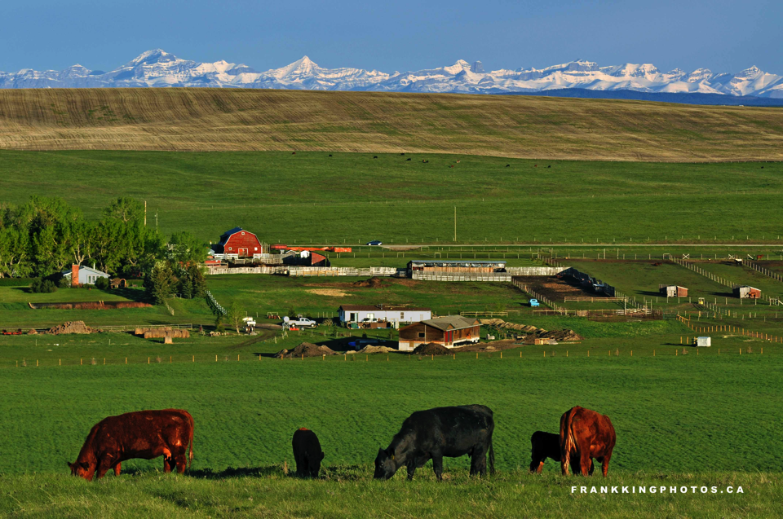

Slide 8
