Slide 1
Making a Burger
(A juicy, scrumptious one)

Slide 2
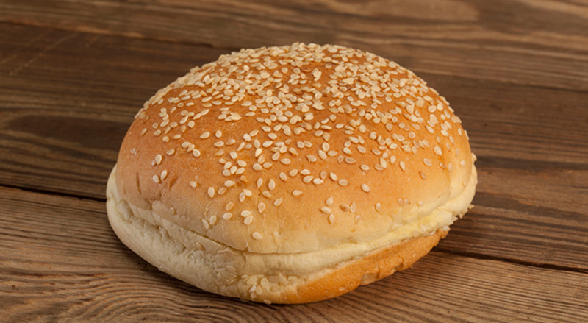
The Bun

Slide 3
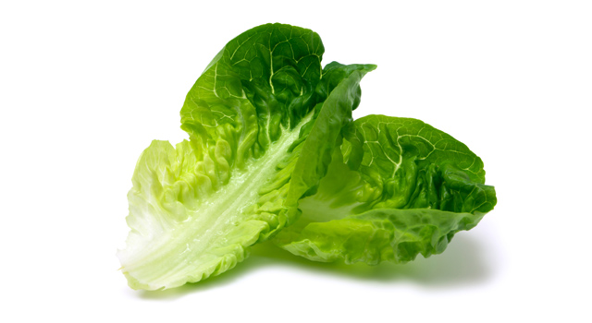
Lettuce

Slide 4
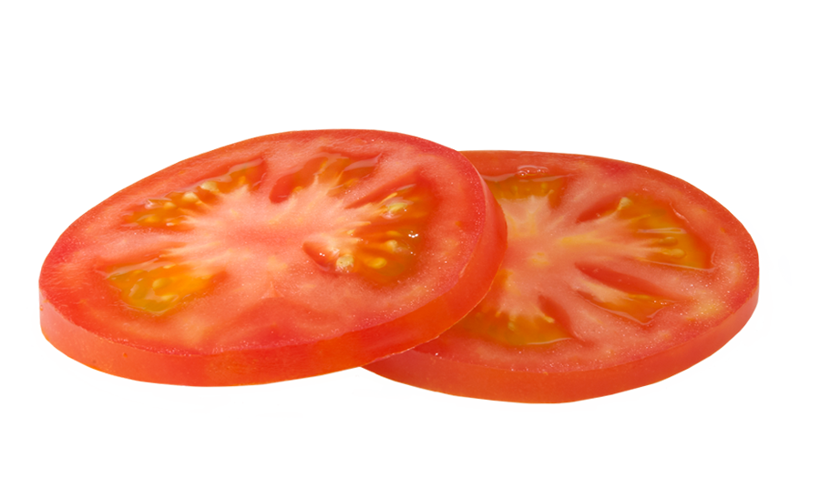
A few juicy tomato slices

Slide 5
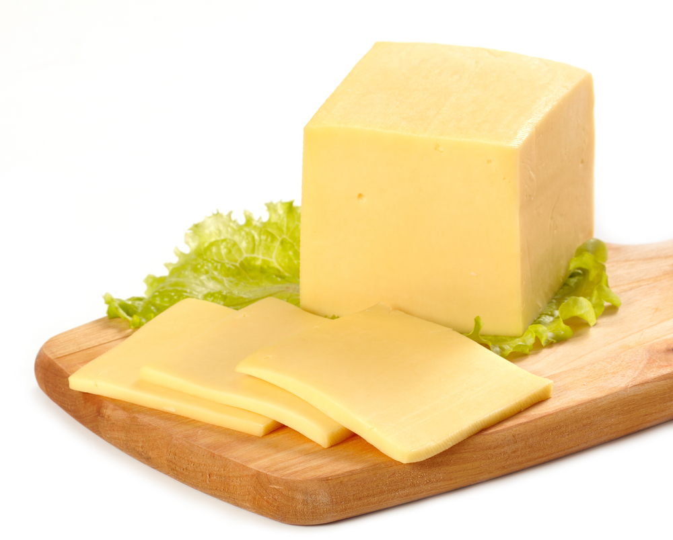
Add some cheese for extra fullness and flavour!

Slide 6
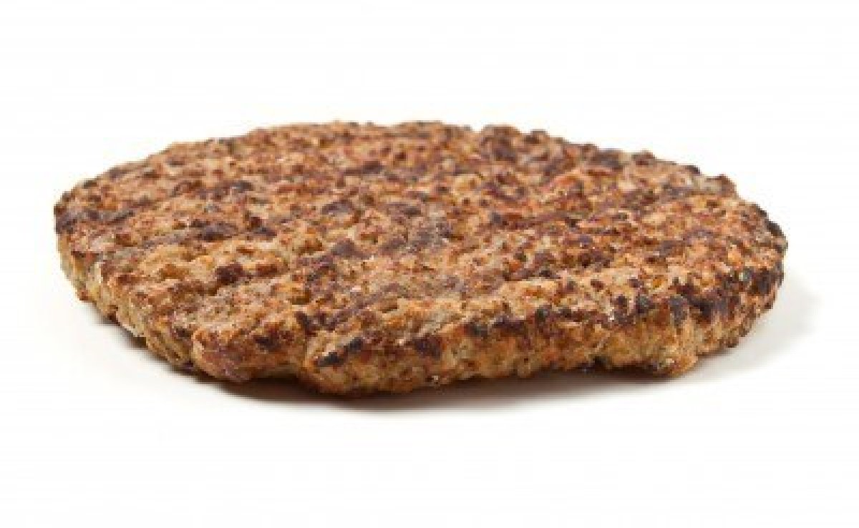
Don’t forget the meat patty!

Slide 7
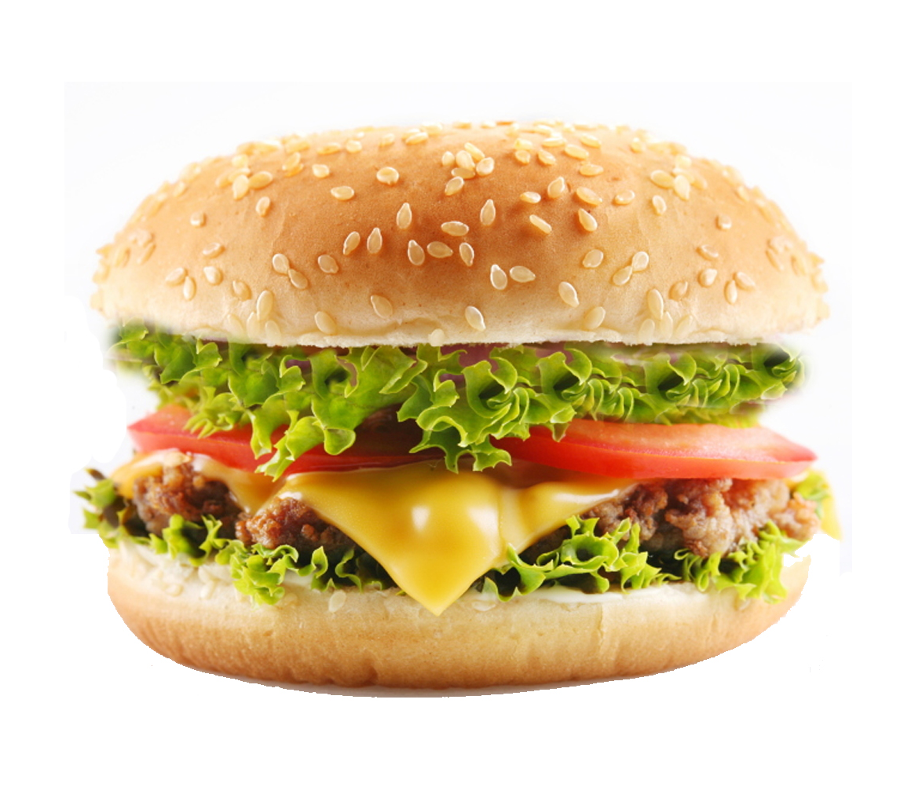
The WHOLE burger!

Slide 8
Think about…
The top and bottom layers
The juicy filling
The colours of the filling
The whole burger
How do these compare to a good paragraph?

Slide 9
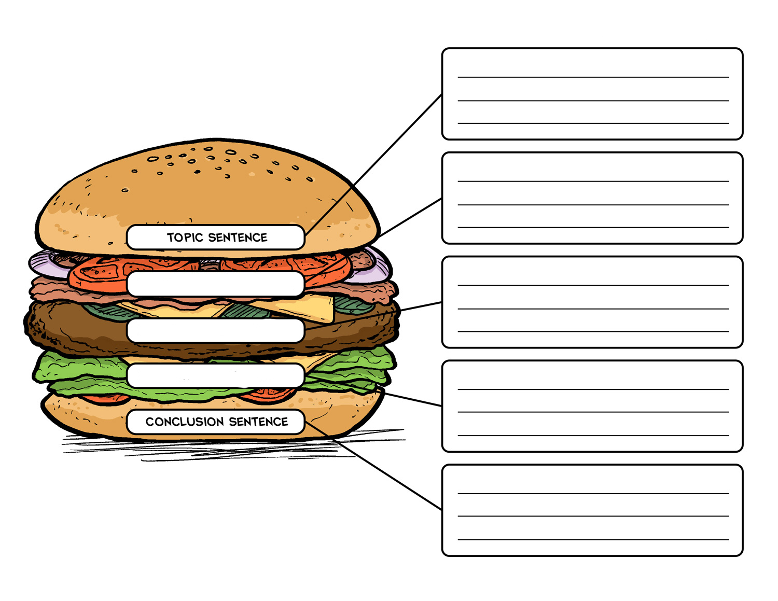
The top and bottom layers
The juicy filling
The colours of the filling
The whole burger
Adapted from: http://www.readingrockets.org/strategies/framed_paragraphs
Notes:
Model a good paragraph and complete this with the class on the whiteboard.
Paragraph topic ideas could include:
I witnessed an accident this morning.
Breakfast is the most delicious meal of the day.
Working as a zoo keeper is awful.

