Slide 1
Floating, Sinking and Dissolving

Slide 2


Slide 3



Slide 4


Slide 5
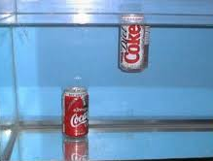

Slide 6
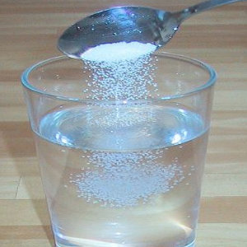

Slide 7
Sink
Float
Dissolve

