Slide 1
How to make
A Cloud in a Jar

Slide 2
You will need:

Slide 3

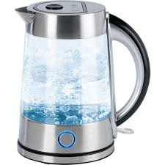
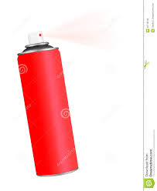
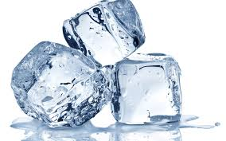
A glass jar
Hot water
Aerosol can
Ice

Slide 4
Steps

Slide 5
Place hot water into the jar and swirl.

Slide 6
2. Place ice on the inside of the lid. Rest the lid on the jar.

Slide 7
3. Take the lid off quickly. Squirt some hairspray into the jar. Replace the lid.

Slide 8

4. Watch the cloud form inside the jar.

Slide 9

5. Remove the lid and watch the cloud escape.

Slide 10
To watch this experiment
and to see more details visit
http://bcove.me/y36bvu6e

