Slide 1
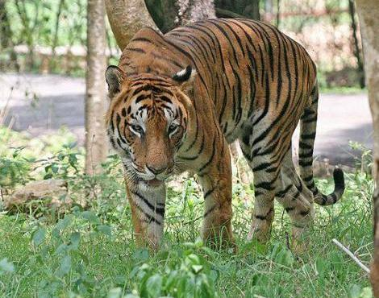
Bengal Tigers

Slide 2
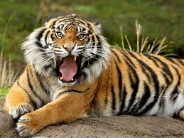
What kind of animal are they?
Tigers are the largest members of the cat family and are renowned for their power and strength.
Scientific Name: Panthera Tigris Tigris

Slide 3
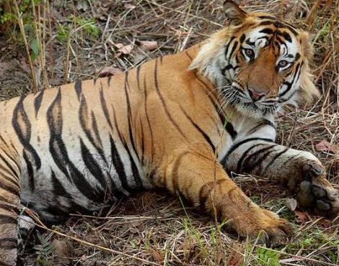
Where do they live?
Bengal tigers live in India and are sometimes called Indian tigers. They are the most common tiger and number about half of all wild tigers.
Bengal tigers live in rainforests and dense grasslands.
.

Slide 4
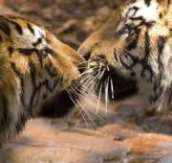
What do they eat?
Tigers are powerful carnivorous hunters that travel many miles to find buffalo, deer, wild pigs, and other large mammals.

Slide 5
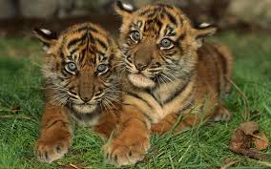
Characteristics
Tigers use their coats as a camouflage which allows them to ambush and pounce on their prey.
No two tigers have exactly the same stripes – just like no two humans share the same fingerprints.

Slide 6
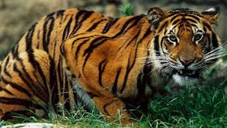
How do they move?
Bengal tigers lie in wait and creep close enough to attack their victims with a quick spring and a fatal pounce. They are quick and vicious.

Slide 7
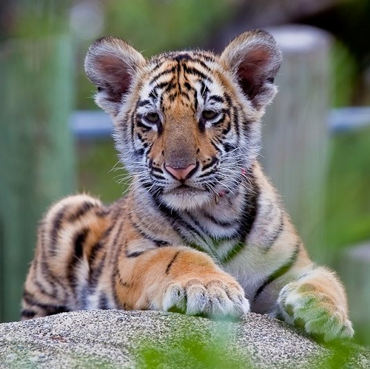
Mothers and Babies
A female tiger will give birth to a litter of two to six cubs
A mother will stay with her cubs for two to three years

Slide 8
