Slide 1
3 Dimensional shapes

Slide 2
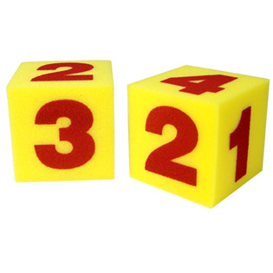
This is a _________________.

Slide 3
How many sides and faces does a cube have?
Notes:
A cube has 12 edges
A cube has 6 faces
8 corners

Slide 4
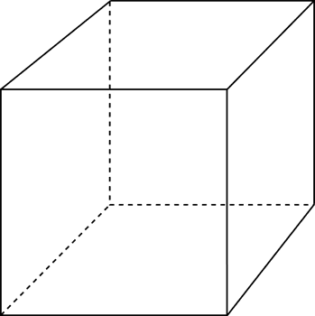

Slide 5
12 sides

Slide 6

6
faces

Slide 7
How many corners does a cube have?

Slide 8
8
corners

Slide 9
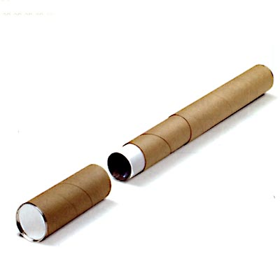
This is a _________________.

Slide 10
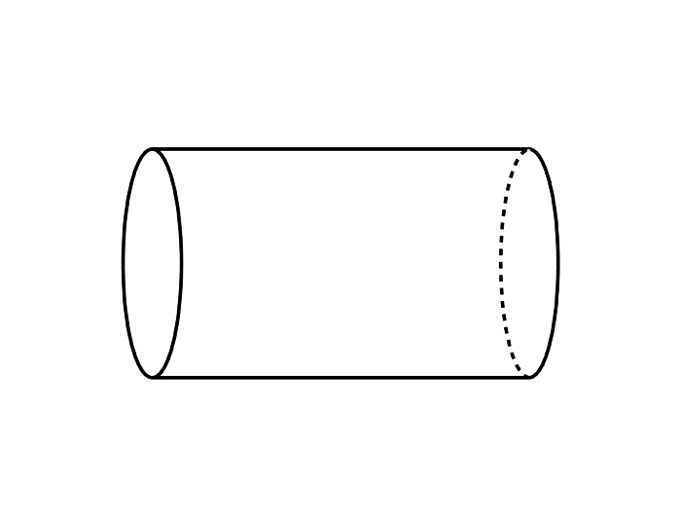

Slide 11
How many faces does a cylinder have?

Slide 12
1
2
3

