Slide 1
Shapes

Slide 3
How many sides does a triangle have?
Are all sides of a triangle the same length?

Slide 4
1
2
3
A triangle has __________sides.

Slide 6
How many sides does a rectangle have?
Are all the sides the same?

Slide 7
1
4
2
3
A rectangle has __________sides.

Slide 9
How many sides does a square have?
Are all sides of a square the same?

Slide 10
1
2
4
3
A square has __________sides.

Slide 11
Pen – ta - gon

Slide 12
How many sides does a pentagon have?
Are all sides the same length?

Slide 13
5
1
4
2
3
A Pentagon has _____________________ sides.

Slide 14
Hex – a - gon

Slide 15
How many sides does a hexagon have?

Slide 16
1
6
2
5
3
4
A Hexagon has _______________ sides.

Slide 17
Oc –ta- gon

Slide 18
How many sides does an octagon have?

Slide 19
1
8
2
7
3
6
4
5
An Octagon has _____________________ sides.

Slide 20
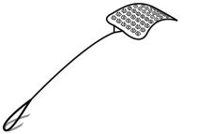
Squat the shape and its sides.
3
6
5
8

