Slide 1
What's the Capacity?

Slide 2
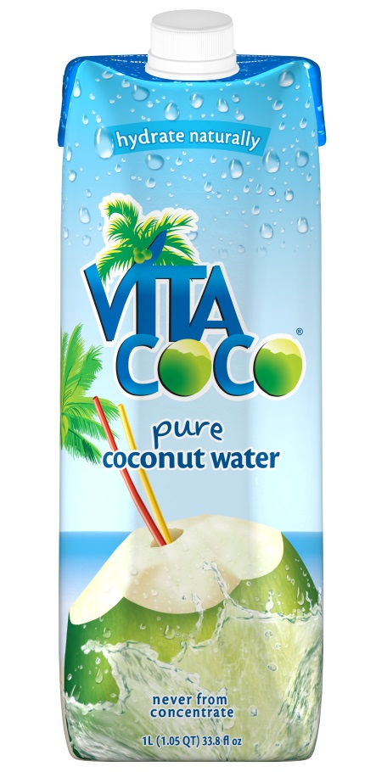
10 Litres B. 1 Litre
C. 15 Litres D. 25 Litres

Slide 3
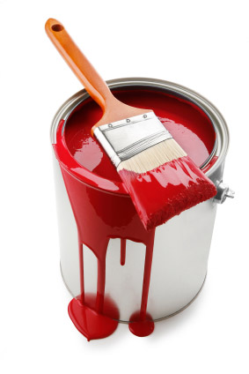
200 Litres B. 10 Litres
C. 2 Litres D. 20 millimetres

Slide 4
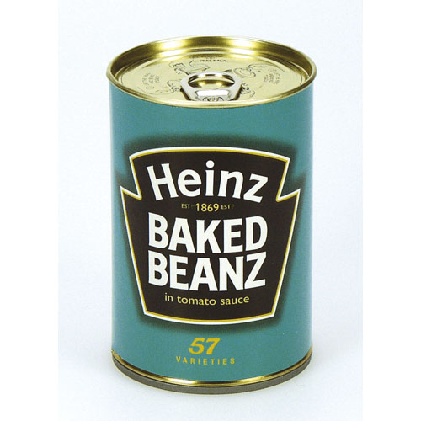
25 mL
25 Litres
2 Litres
250 mL

Slide 5
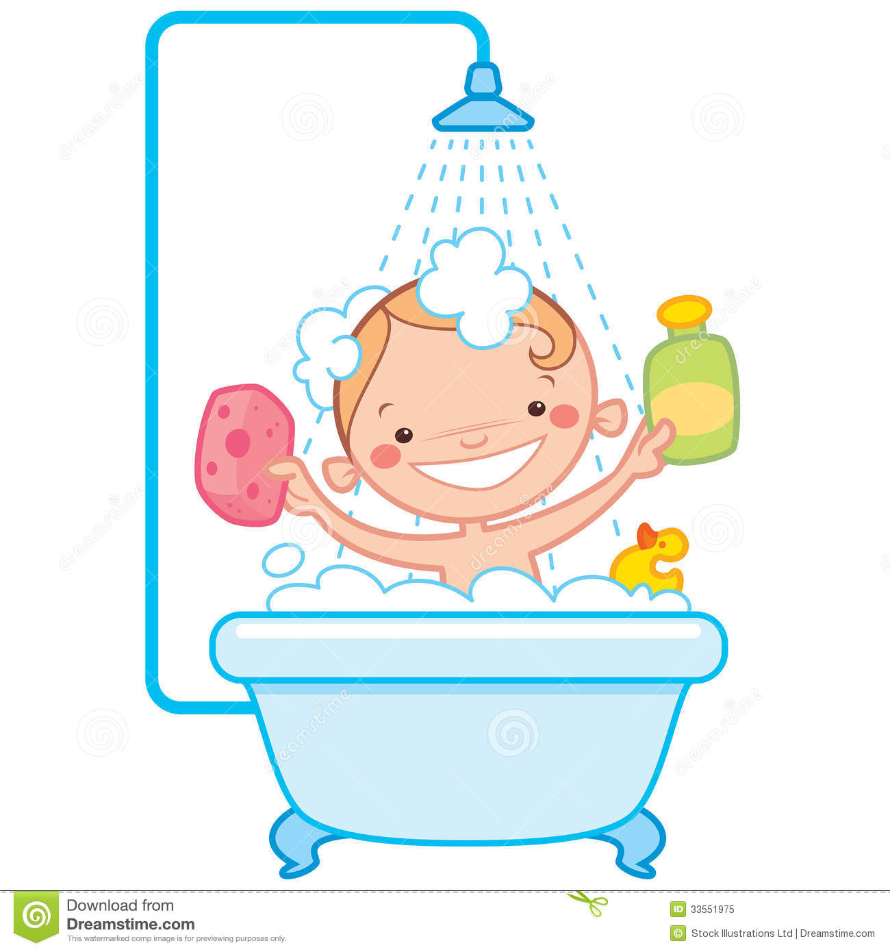
1000 mL B.150 Litres
C. 5000 Litres D.300 Litres

Slide 6
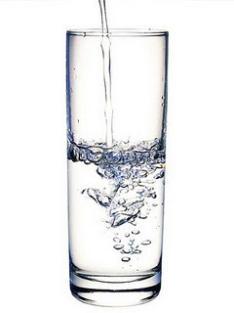
500 Litres B. 350 Litres
C. 500 mL D. 300 mL

Slide 7
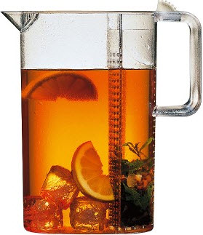
12 litres B. 1 litre
C. 20cups D. 100 mL

Slide 8
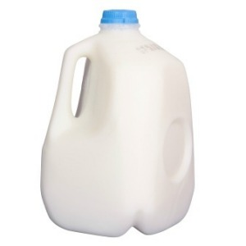
2 litres B. 20 L
C. 20 000 mL D. 8 mL

Slide 9
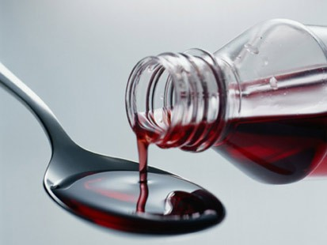
15 mL
1500 mL
2 L
80 mL

Slide 10
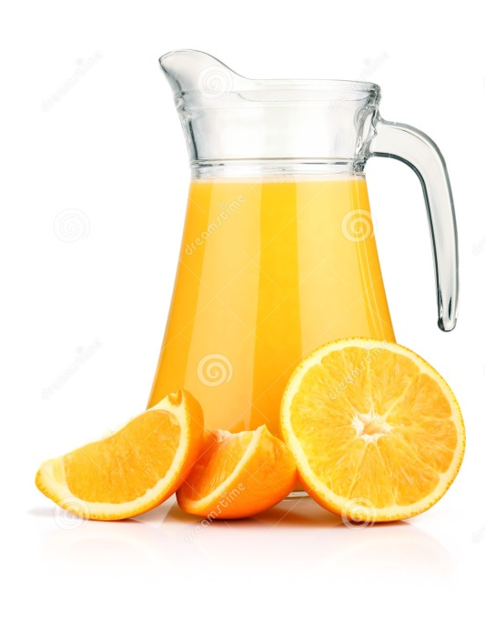
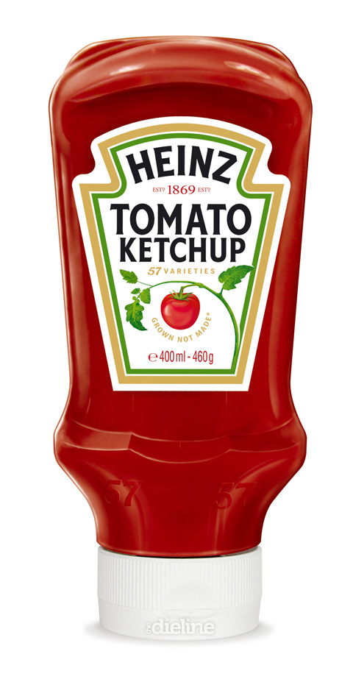
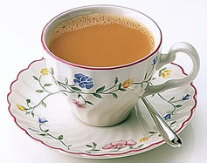
Which would hold close to 1 litre?

Slide 11
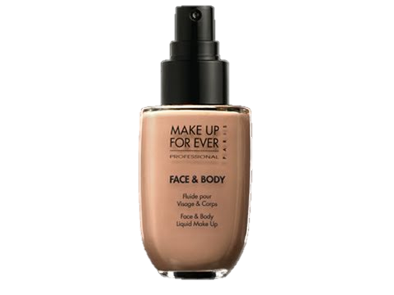
Which one would have a capacity of 20 mL

Slide 12
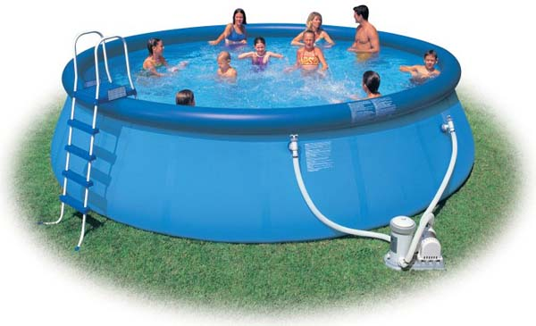
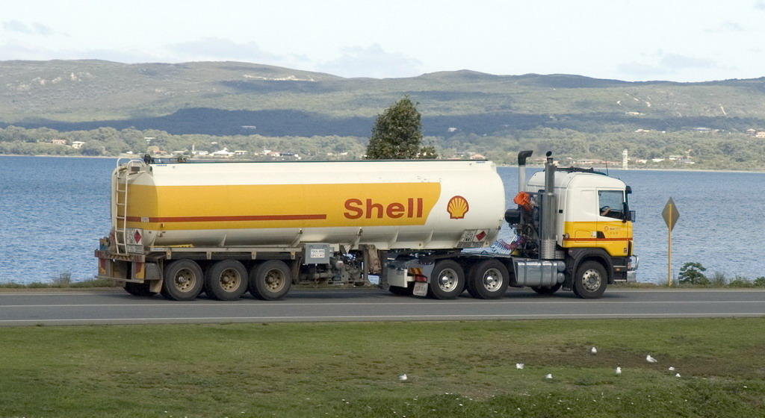
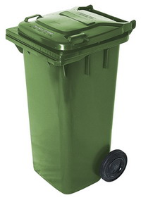
Which would hold the most?

Slide 13

Which would hold the least?

Slide 14
Image References
http://vitacoco.com.au/vita-coco-100-pure-coconut-water-12-x-1-litre.html
http://picasaweb.google.com/104257000439528596522/CLIPARTREALHERRAMIENTAS?gsessionid=N1RQe8aBPfM-K29ck6xDug#
http://fitchiq.blogspot.com.au/2011/03/what-in-baked-beans-is-thiswelcome-to.html
http://www.dreamstime.com/royalty-free-stock-photo-happy-cartoon-baby-kid-bath-tub-having-bathtub-holding-shampoo-bottle-scrubber-having-rubber-duck-toy-image33551975
http://afemmeduncertainage.blogspot.com.au/2011/11/great-snack-debate.html
http://www.productreview.com.au/p/bodum-ceylon-iced-tea-jug.html

Slide 15
Image References
http://mymusicshow.tv/reviews/cardboard-vs-plastic-whats-best-for-your-milk
http://coughsyrupabuse.com/cough-syrup-abuse-symptoms
http://www.phrases.org.uk/meanings/my-cup-of-tea.html
http://www.dreamstime.com/stock-photo-jug-orange-juice-orange-fruits-isolated-image18858450
http://blog.infotrends.com/?p=3552
http://www.youtube.com/watch?v=Oi2Vd-YvAnY\
http://www.victor.sa.gov.au/page.aspx?u=823
http://commons.wikimedia.org/wiki/File:Shell_tanker_truck.jpg
http://www.mudremisli.com/tag/osmijeh/

