Slide 1
Reciprocal Reading

Slide 2

Huh?
Reciprocal Reading means you will conduct a reading group on your own without a teacher!
You will learn the 4 roles of reading and how to become a very good reader!

Slide 3
Roles
There are 5 Roles in Reciprocal Reading
The Leader
The Questioner
The Predictor
The Clarifier
The Summariser
Each member plays an important role in Reciprocal Reading.

Slide 4
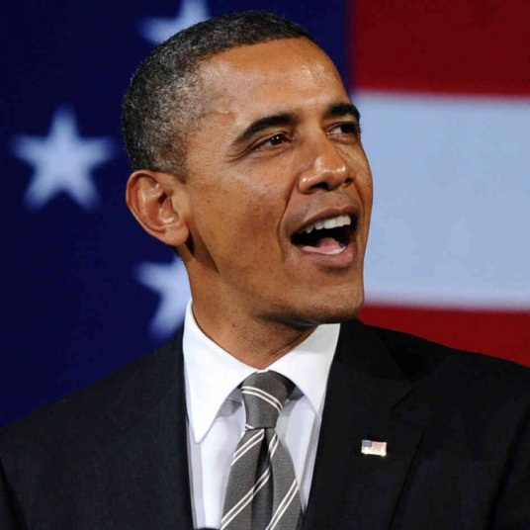
The Leader
The leader is responsible for:
Nominating who will do each job
Instructs the group on what to read
Invites each group member to perform their role after reading each chunk
Make sure everyone is staying on task and engaged!

Slide 5

The Questioner
The Questioner is responsible for:
Coming up with questions which will help the group understand the text.
Thinks of questions as they are reading the text.
Use these prompts to help
Who..? What..? When..? Where..? Why..? How..?

Slide 6
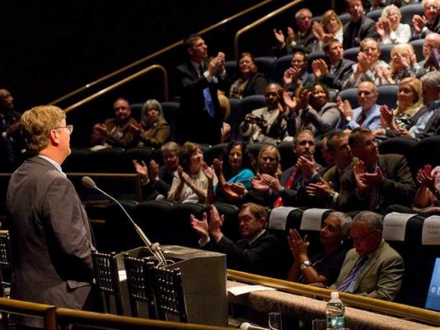
The Summariser
The Summariser is responsible for:
Retelling the group what they have just read in their own words
Tell the important items only!
Keep it simple son!
Used as a reminder
Use these phrases to assist you:
The most important information is…….
The story is set in…… The characters are…….
We have just read that……..

Slide 7

The Predictor
The Predictor is responsible for:
Using the information read in the text to predict what they will learn or happen next
Changing their predictions as they progress through the text.
Use these phrases to assist you:
I predict that….. I wonder if……..
What would happen if….. I believe that….

Slide 8

The Clarifier
The Clarifier is responsible for:
Making sense of a word that you’re not sure of
Looking for any sentences which don’t make sense
Assisting anyone who is confused
Assistance for clarifiers:
Stop and think about what you have just read.
Look for base words, root words and suffixes
Try connecting to any experiences you may have had
Continue reading to see if meaning makes sense.

Slide 9
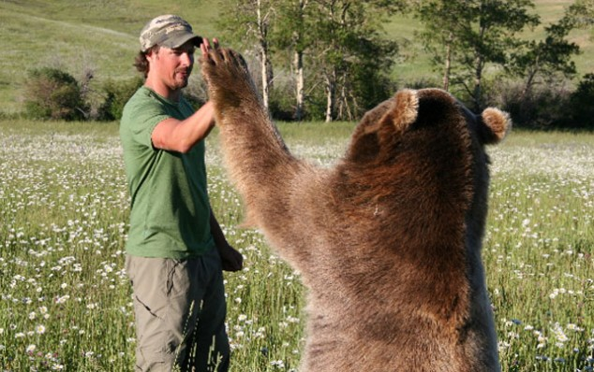
Reminder of Roles
Remember that the 5 roles of Reciprocal Reading are:
The Leader
The Questioner
The Summariser
The Predictor
The Clarifier

Slide 10
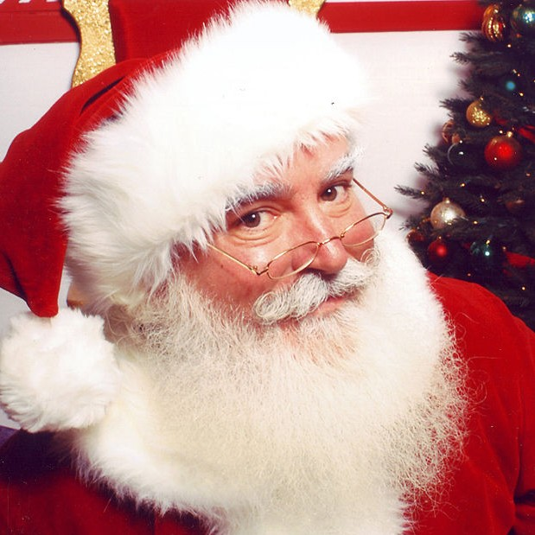
Use these 4 strategies to help you become a great reader!!!!! (like Santa!)

